Slide 1
Building Personal Search Engine Using Vector Databases

Slide 2
Goal and Agenda
Goal: Enable you to create a Modern AI Search Engine on your own data.
Agenda:
Context Setting
Understand LLMs and Transformers.
Understand the core concepts behind Vector Databases and Semantic Search
Discuss the Retrieval Augmented Generation for QnA.
How to chat with your data?
Optimizing Context windows.
Engage in hands-on exploration, implementing the ideas discussed.
Notes:
Slide 1: Welcome and Objectives
Welcome attendees
Outline the objectives of the presentation
Ice breaker activity to engage attendees
Set the stage for exploration

Slide 3
Prereqs
Goal: Enable you to create a Modern AI Search Engine on your own data.
Prerequisites:
Basics of NLP
Python
Langchain (helpful but not required)
Notes:
Slide 1: Welcome and Objectives
Welcome attendees
Outline the objectives of the presentation
Ice breaker activity to engage attendees
Set the stage for exploration

Slide 4
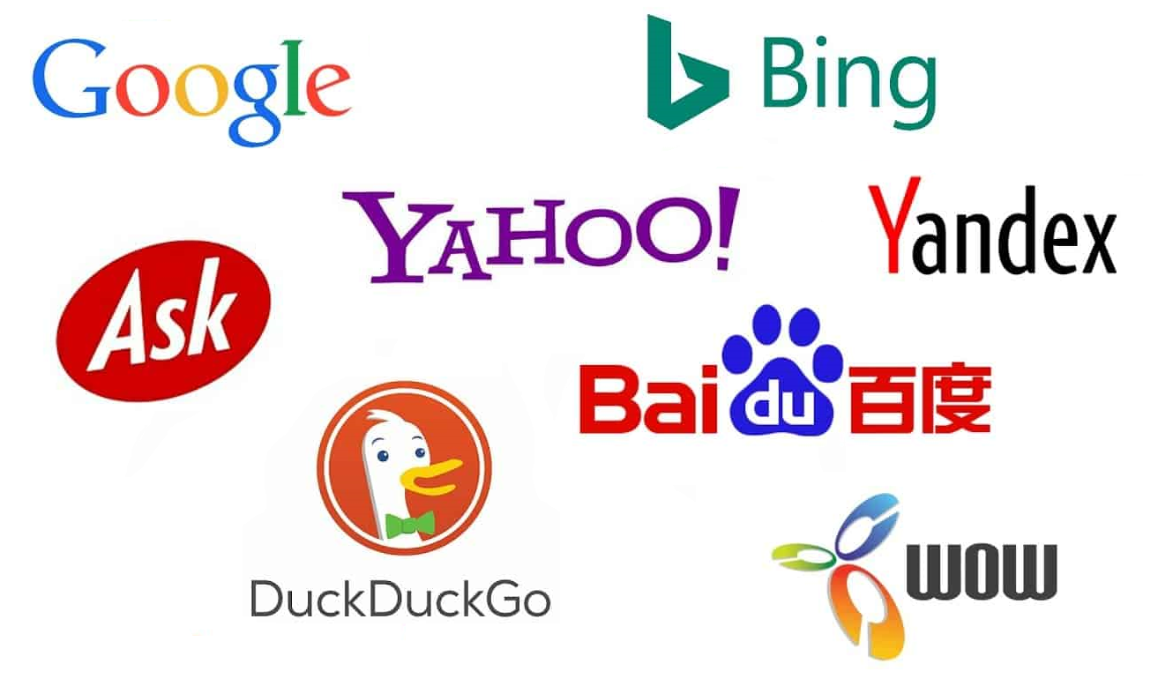
Icebreaker
Ice Breaker:
Raise your hand if your organization is using Search
In some way?
Ice Breaker #2:
Keep your hand raised if your organization is using Semantic Search?
Ice Breaker3 :
Keep your hand raised if you work for Big tech firm
Notes:
Slide 1: Welcome and Objectives
Welcome attendees
Outline the objectives of the presentation
Ice breaker activity to engage attendees
Set the stage for exploration

Slide 5
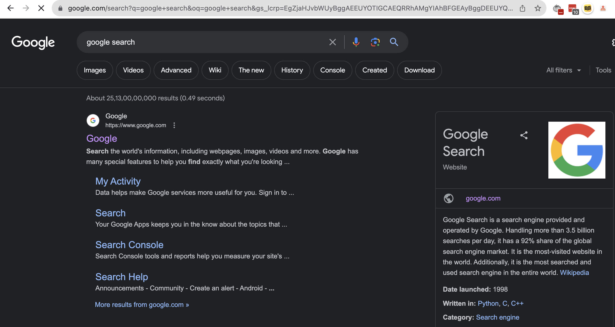
IR Basics
Query. A formal statement of your information need. E.g., a search string.
• Object. The entity inside your content collection. E.g., a document.
• Relevance. The measure of how well an object satisfies the information need
• Ranking. Ordering of relevant results based on the desirability
Notes:
We will explore the fundamental concepts of Information Retrieval (IR) that play a crucial role in organizing and retrieving information effectively.
1. Query
A formal statement of your information need.
For instance, a search string or a set of keywords that define what you are looking for.
2. Object
The entity inside your content collection that you want to retrieve or search for.
For example, this could be a document, a webpage, an image, or any other unit of information.
3. Relevance
The measure of how well an object satisfies the information need defined in your query.
IR systems aim to determine the relevance of objects to present the most suitable results.
4. Ranking
The process of ordering relevant results based on their desirability or perceived importance.
An effective ranking algorithm ensures that the most relevant objects are displayed prominently.

Slide 6
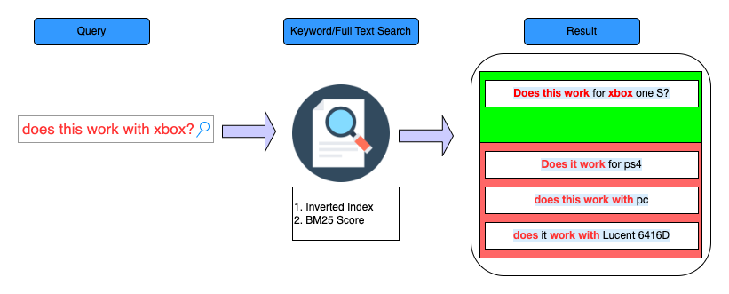
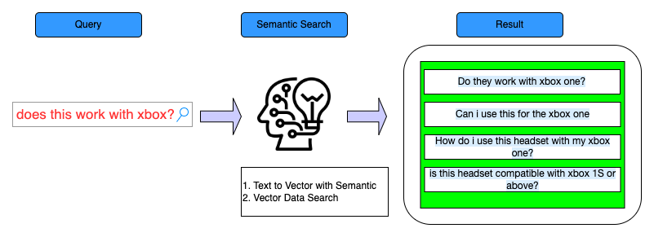
Context setting
Introduction to Search Engines
Types of Search
Keyword Search
Semantic Search
Keyword Search
Semantic Search
Notes:
We will lay the groundwork for understanding search engines and the types of searches they employ to help users find relevant information efficiently.
1. Introduction to Search Engines
Search engines play a pivotal role in organizing and retrieving vast amounts of information available on the internet.
They serve as powerful tools to help users navigate through the digital realm and find specific content based on their queries.
2. Types of Search
Search engines utilize different techniques to find and present search results to users.
Two primary types of searches are commonly employed:
a. Keyword Search
In this type of search, users enter specific keywords or phrases related to their information needs.
The search engine then scans its index to find web pages or content containing the entered keywords.
Along with the index, the search engine employs algorithms like BM25 Score to calculate the relevance of each web page to the entered keywords.
BM25 Score is a ranking algorithm that evaluates the relevance of a document based on the frequency and distribution of the query terms within the document.
Results are displayed based on relevance, typically presenting a list of links to relevant web pages.
b. Semantic Search
Semantic search is an advanced search technique that aims to understand the user's intent and the contextual meaning behind the search query.
Instead of relying solely on exact keyword matches, semantic search takes into account the user's intent and the context of the query to deliver more relevant results.
The user input query is transformed into a vector representation using "text to Vector with Semantic" techniques.
This vector representation captures the semantic meaning of the query, enabling the search engine to comprehend the user's intent better.
The search engine then uses "Vector Data Search" to find documents or content that closely align with the vector representation of the query.
The result is a more contextually relevant set of search results, which enhances the search experience for users.

Slide 7
Context setting
Introduction to Search Engines
Types of Search
Keyword Search
Semantic Search
Keyword Search
Semantic Search
Notes:
Search Engines:
Search engines work as the librarians of the internet, scanning billions of pages to provide the most relevant results for your search queries.
Traditional search engines operate primarily by scanning webpage text for matching keywords.
Limitations of Traditional Search Engines:
Traditional methods are limited, akin to finding a book in a library by only looking at the words on the covers without understanding the actual content of the book.
AI Revolution in Search Engines:
AI enables search engines to better understand the content and context of web pages and the user's intent.
AI can distinguish the context in which a word is used, enhancing the relevance of search results.
AI can personalize search results based on factors like previous searches and location.
Advanced Capabilities of AI-powered Search Engines:
AI-powered search engines can analyze and understand various data types including text, images, videos, and even voice commands.
As a result, AI has transformed search engines from simple keyword-matching tools into sophisticated systems that understand and cater to the nuanced needs of users.
5. Types of Search
Search engines utilize different techniques to find and present search results to users.
Two primary types of searches are commonly employed:
a. Keyword Search
In this type of search, users enter specific keywords or phrases related to their information needs.
The search engine then scans its index to find web pages or content containing the entered keywords.
Along with the index, the search engine employs algorithms like BM25 Score to calculate the relevance of each web page to the entered keywords.
BM25 Score is a ranking algorithm that evaluates the relevance of a document based on the frequency and distribution of the query terms within the document.
Results are displayed based on relevance, typically presenting a list of links to relevant web pages.
b. Semantic Search
Semantic search is an advanced search technique that aims to understand the user's intent and the contextual meaning behind the search query.
Instead of relying solely on exact keyword matches, semantic search takes into account the user's intent and the context of the query to deliver more relevant results.
The user input query is transformed into a vector representation using "text to Vector with Semantic" techniques.
This vector representation captures the semantic meaning of the query, enabling the search engine to comprehend the user's intent better.
The search engine then uses "Vector Data Search" to find documents or content that closely align with the vector representation of the query.
The result is a more contextually relevant set of search results, which enhances the search experience for users.

Slide 8



Context setting
Keyword Search
moglix.com
Semantic Search (amazon.com)
Notes:
We will explore examples of different search techniques, including Keyword Search and Semantic Search, using well-known websites as examples.
1. Example of Keyword Search: "moglix.com"
In a Keyword Search, users enter specific keywords or phrases related to their information needs.
For instance, if you search for "moglix.com," the search engine scans its index for web pages or content containing the exact keywords "moglix" and "com."
The results will typically display a list of links to web pages relevant to the entered keywords.
2. Example of Semantic Search: "amazon.com"
Semantic Search is an advanced search technique that aims to understand the context and intent behind the search query.
When you search for "amazon.com" using Semantic Search, the search engine goes beyond the exact keyword match.
It interprets the user's intent and context to provide more relevant results related to Amazon, the well-known online retail giant.
The Semantic Search technique enables the search engine to grasp the user's intent, considering factors like user behavior, search history, and natural language understanding.
Next slide, we will dive deeper into the workings of Keyword Search and Semantic Search, exploring the underlying technologies that make these search techniques more efficient and user-friendly.

Slide 9
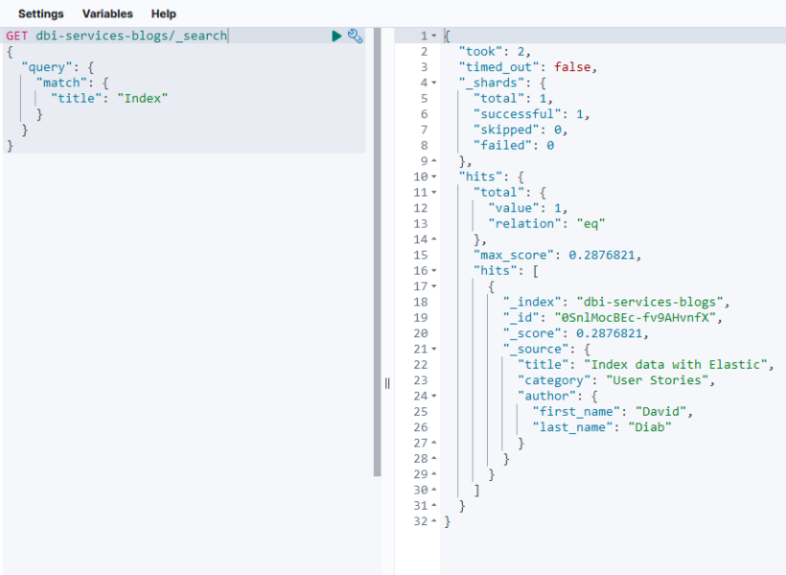
How Search Engines work (Keyword Search)
Keyword Search
Matches the exact words to the inverted index.
Algorithms For Keyword search and default similarity algorithm
TF-IDF
Practical Search Algorithm( Elastic search’s default algorithm)
Scoring plays an important part in determining relevance during a search operation.
Notes:
We will delve into the mechanics of Keyword Search, exploring how search engines process and retrieve information based on exact word matches.
1. Keyword Search
In Keyword Search, users enter specific keywords or phrases related to their information needs.
The search engine then matches these exact words to the inverted index, a data structure that maps words to their corresponding documents or web pages.
By matching the user's input with the inverted index, the search engine identifies the documents or web pages containing the exact keywords.
2. Algorithms for Keyword Search and Default Similarity Algorithm
Keyword Search employs various algorithms to calculate the relevance of documents to the user's search query.
Two common algorithms used in Keyword Search are:
a. TF-IDF (Term Frequency-Inverse Document Frequency)
TF-IDF measures the importance of a term within a document relative to the entire collection of documents.
It considers both the term frequency (how often a term appears in a document) and the inverse document frequency (how rare or common the term is across the entire document collection).
Higher TF-IDF scores indicate greater relevance of a term to a specific document and the user's search query.
b. Practical Search Algorithm (Elasticsearch's Default Algorithm)
Elasticsearch, a popular search engine, uses its default search algorithm, which combines multiple factors to determine document relevance.
The scoring process plays an important part in determining the relevance of documents during a search operation.
The practical search algorithm takes into account factors like term frequency, document frequency, field length normalization, and other statistical measures to rank search results.

Slide 10
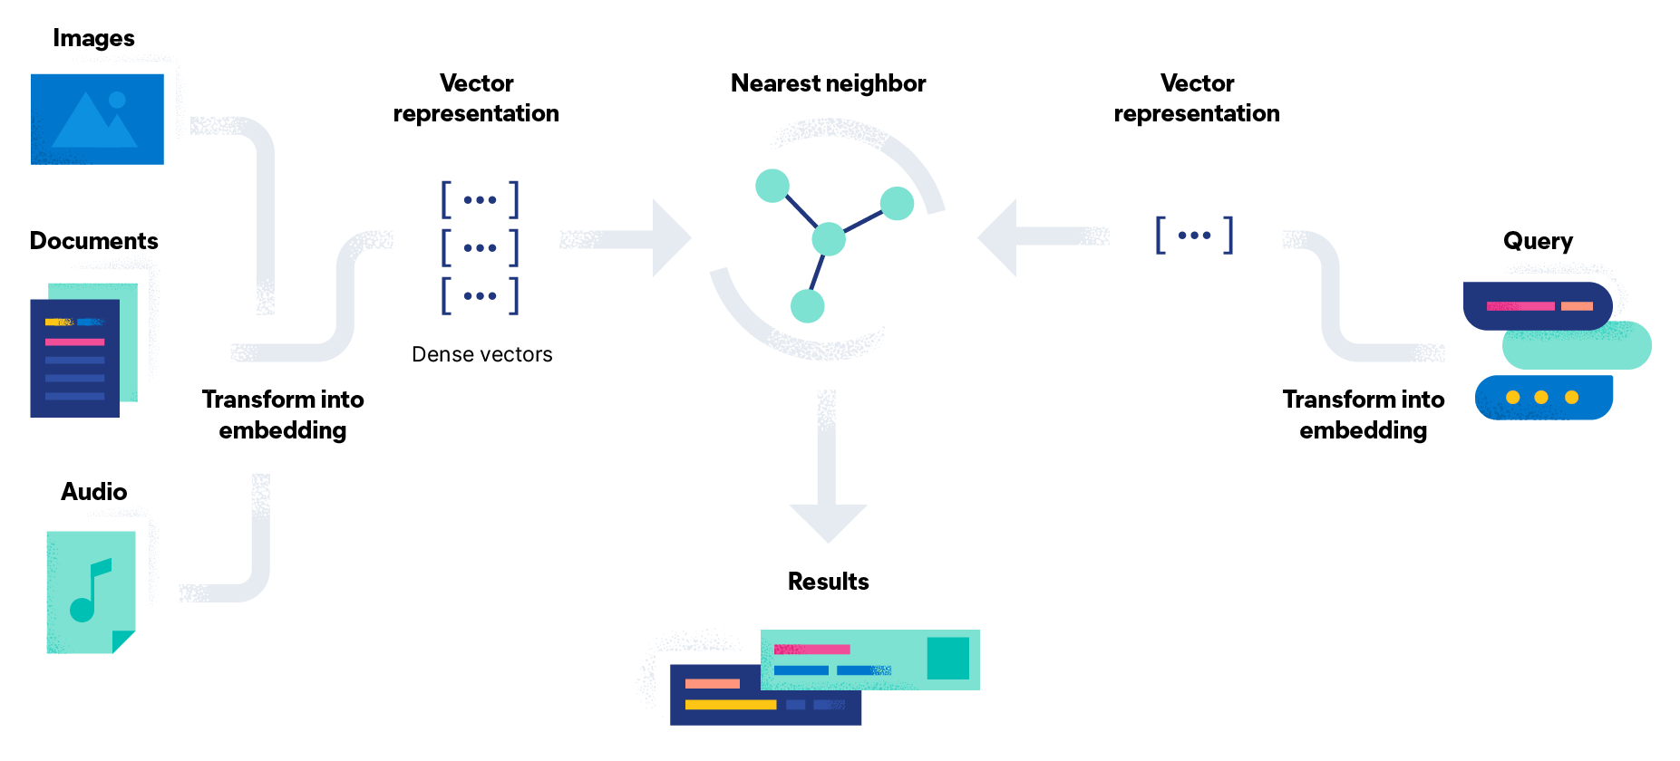
How Semantic Search Engines work
Pillars of Semantic Search
NLP and Text Data Vectorization
Vector Search
Algorithms Behind Generating Vector Embeddings | Algorithms Behind Vector Search
Word2vec | k-Nearest Neighbors (k-NN)
Open AI (what we will use) | Hierarchical Navigable Small World (HNSW)
Clip(Multimodal) | Product Quantization
Notes:
We will explore the role of Natural Language Processing (NLP) in search engines and the Machine Learning algorithms used to craft efficient AI-powered search engines.
1. What is NLP?
NLP, or Natural Language Processing, is a subfield of Artificial Intelligence that focuses on the interaction between computers and human language.
It empowers machines to understand, interpret, and generate human language in a way that makes it easier for users to interact with technology.
2. The Role of NLP in Search Engines
NLP plays a crucial role in enhancing the capabilities of search engines, making them more user-friendly and effective.
The key roles of NLP in search engines are:
a. Understanding User Queries
NLP enables search engines to comprehend the intent and context behind user queries, allowing for more relevant search results.
By understanding the natural language in queries, search engines can provide contextually appropriate responses.
b. Semantic Search
NLP enables search engines to perform Semantic Search, where the meaning and context of queries are considered instead of exact keyword matches.
This allows search engines to deliver more accurate and relevant results, catering to user intent.
3. Machine Learning Algorithms in Crafting Efficient AI Search Engines
Efficient AI-powered search engines leverage various Machine Learning algorithms to enhance search performance and user experience.
a. Hierarchical Navigable Small World (HNSW)
HNSW is an algorithm that builds a hierarchical graph structure to index high-dimensional vectors efficiently.
It is known for its fast search speed and low memory usage, making it ideal for handling large-scale datasets.
b. Inverted File with Approximate Distance Calculation (IVFADC)
IVFADC is an algorithm that uses an inverted index structure to index high-dimensional vectors.
It is renowned for its fast search speed and ability to handle large-scale datasets effectively.
c. Inverted File with Product Quantization (IVFPQ)
IVFPQ is an algorithm that employs product quantization to compress high-dimensional vectors before indexing.
It excels in high accuracy and is well-suited for handling large-scale datasets.
d. Product Quantization (PQ)
PQ is an algorithm that divides high-dimensional vectors into subvectors and quantizes them separately, resulting in high compression ratio and fast search speed.
Incorporating Natural Language Processing and leveraging Machine Learning algorithms in search engines transforms them into efficient AI-powered tools. These technologies make search engines more intuitive, contextually aware, and capable of handling vast amounts of data.

Slide 11
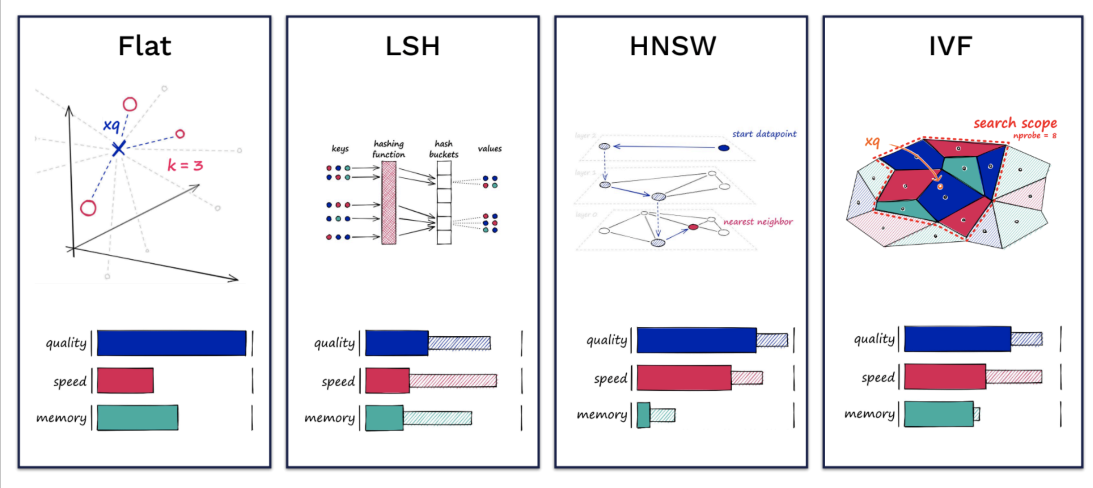
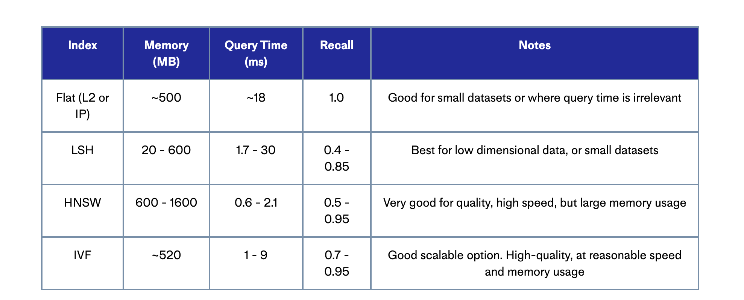
Semantic Search Algorithms
Vector Embeddings(in semantic search context) are a special kind of data structure that allow for easier similarity matching for ANN algorithms.
Trade off between quality, speed and memory.
From search perspective, the algo is less important as opposed to vector storage layer.
https://www.pinecone.io/learn/series/faiss/vector-indexes/
Notes:
We will explore the significance of Vector Embeddings in semantic search context and the trade-offs between quality, speed, and memory in different algorithms.
1. Vector Embeddings in Semantic Search
Vector Embeddings are a specialized data structure used in semantic search to enable efficient similarity matching for Approximate Nearest Neighbor (ANN) algorithms.
These embeddings represent the semantic meaning of data, allowing search engines to match query vectors with indexed content vectors effectively.
2. Trade-Offs between Quality, Speed, and Memory
In semantic search algorithms, there is a trade-off between the quality of search results, the speed of query execution, and the memory usage.
3. Importance of Vector Storage Layer
From a search perspective, the choice of the algorithm is essential, but the vector storage layer plays a critical role in determining the overall performance of the search engine.
Different algorithms can be used in conjunction with various vector storage layers to achieve the desired balance between quality, speed, and memory usage.
4. Algorithm Notes:
Flat: Good for small datasets or cases where query relevance is not a concern.
LSH (Locality-Sensitive Hashing): Best for low-dimensional data or small datasets.
HNSW (Hierarchical Navigable Small World): Very good for quality and high speed but has large memory usage.
IVF (Inverted File): Good scalable option with high-quality results at reasonable speed and memory usage.
Understanding the different Semantic Search Algorithms and their trade-offs is crucial in designing efficient search systems. Depending on the specific use case and the dataset's characteristics, different algorithms and vector storage layers can be selected to achieve the desired balance of quality, speed, and memory usage.

Slide 12
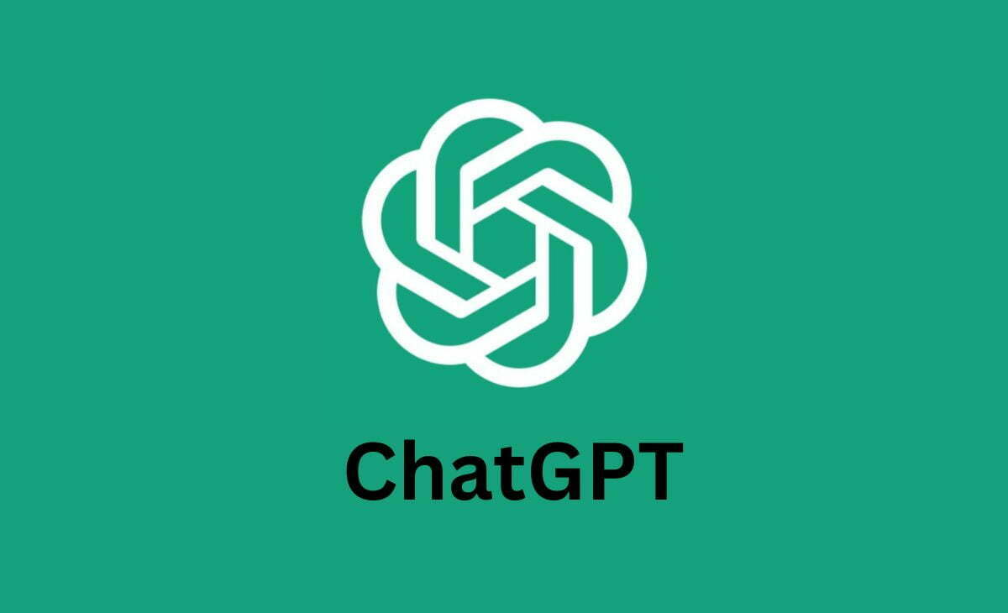

Large Language Models
Foundation models are specialized transformers for NLP with billions of parameters.
Perform tasks like translation, sentiment analysis, and chatbot conversations without being specifically trained for them
Some are available for finetuning, more commercial ones are tunable through prompts.
Notes:
We will explore the power and versatility of foundation models with billions of parameters in Natural Language Processing (NLP). These models excel at a wide range of tasks and can be utilized without fine-tuning through the use of prompting techniques.
1. Foundation Models in NLP
Large Language Models are specialized transformers designed for NLP with billions of parameters.
They form the foundation of modern Natural Language Processing techniques, enabling groundbreaking advancements in language understanding and generation.
2. Versatility in Task Performance
These large language models can perform various NLP tasks, including but not limited to:
Translation: Converting text between different languages.
Sentiment Analysis: Determining the sentiment or emotion conveyed in a given text.
Chatbot Conversations: Engaging in natural language conversations with users.
3. Generalized Task Handling
One of the remarkable features of these models is their ability to perform tasks without being specifically trained for each one.
Unlike traditional models that require task-specific training, large language models can adapt to various tasks with minimal fine-tuning or even without it.
4. Utilizing Prompting Techniques
Large language models can be employed without fine-tuning through the use of "prompting" techniques.
Prompts are specific instructions or cues provided to the model to guide its behavior and generate desired responses.
These prompts enable the model to perform tasks based on a user's instructions, making them highly flexible and user-friendly.
5. Commercial Availability
Many large language models are available for commercial use, offering extensive capabilities for businesses and developers.
Some models are accessible for fine-tuning, allowing users to tailor the model to their specific needs and tasks.

Slide 13
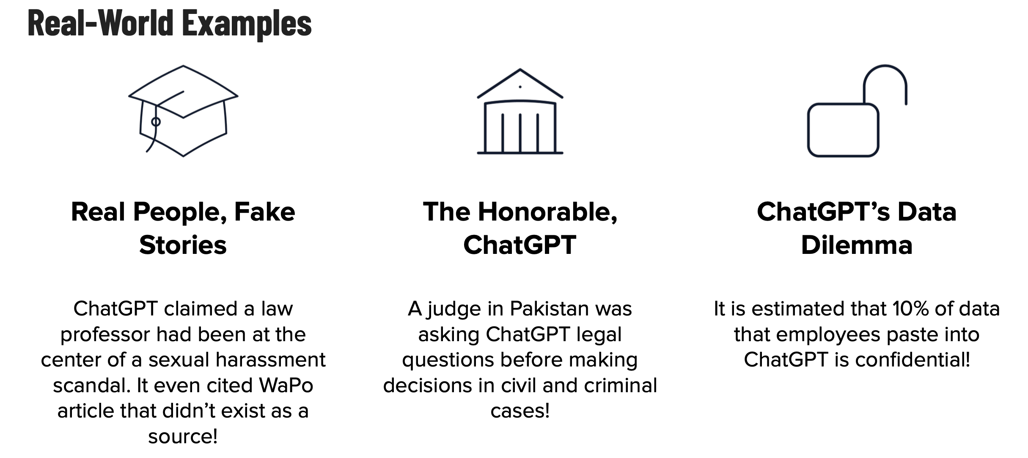
Pitfalls
Notes:
We will examine real-world examples and challenges associated with AI language models like Chat GPT. AI language models like Chat GPT have demonstrated remarkable capabilities, but they are not immune to pitfalls.
a. Real People, Fake Stories
In some instances, Chat GPT has generated content with misleading or false information.
For example, it once claimed that a law professor was involved in a sexual harassment scandal, citing a non-existent WaPo article as a source.
b. The Honorable ChatGPT
There have been cases where Chat GPT has been consulted for legal advice in real civil and criminal cases.
A judge in Pakistan reportedly sought legal input from the AI model before making decisions.
c. ChatGPT's Data Dilemma
The input data given to Chat GPT can sometimes raise privacy and confidentiality concerns.
It is estimated that up to 10% of data that employees paste into Chat GPT is of a confidential nature.
This poses a significant risk of sensitive information being inadvertently exposed.
While AI language models have made significant strides in natural language processing, these real-world examples highlight the importance of careful usage and responsible deployment. Addressing pitfalls is crucial to ensure ethical and secure AI implementations.

Slide 14
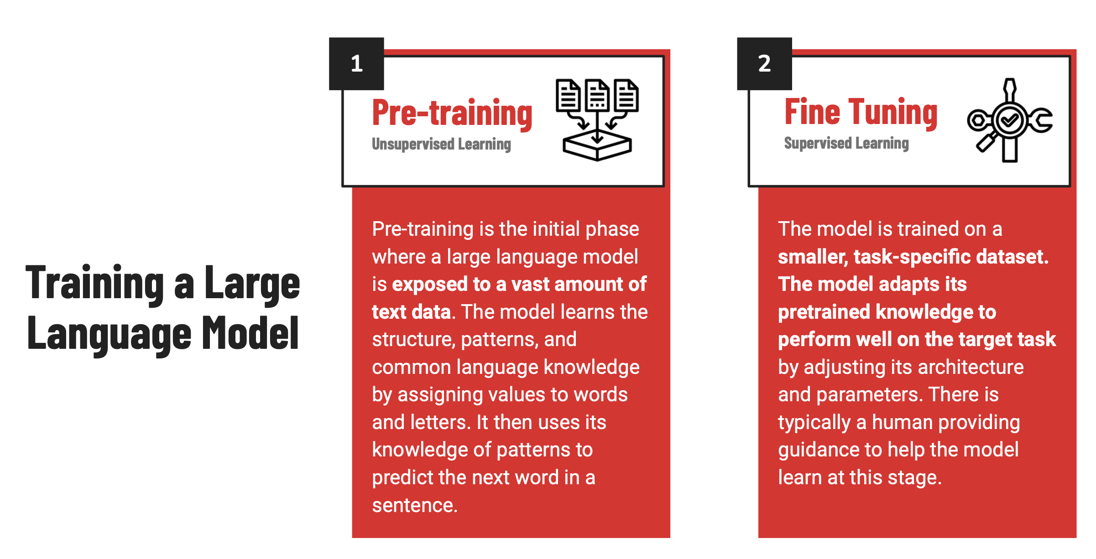
Custom LLMs/Fine Tuning
One way to search on your data is to train your own LLM or finetune an existing one.
Notes:
We will explore the process of training your own Large Language Model (LLM) or fine-tuning an existing one to make it more tailored to your specific needs and tasks
1. Training a Large Language Model
To create a custom Large Language Model, the process typically involves two main phases: Pre-training and Fine Tuning.
2. Pre-training
Pre-training is the initial phase where the LLM is exposed to an extensive corpus of text data, often from diverse sources and domains.
The model undergoes unsupervised learning, learning the structure, patterns, and common language knowledge by assigning values to words and letters.
During pre-training, the LLM uses its knowledge of patterns to predict the next word in a sentence, effectively learning the underlying context and semantics of the language.
3. Fine Tuning
Fine Tuning is the subsequent phase where the pre-trained LLM is further trained on a smaller, task-specific dataset.
Fine Tuning involves supervised learning, where the LLM adapts its pretrained knowledge to perform well on the target task by adjusting its architecture and parameters.
A human provides guidance and input to the LLM during fine-tuning, helping the model learn and specialize for the specific task it needs to excel at.
Custom LLMs and Fine Tuning offer a powerful way to leverage existing language models and tailor them to your unique requirements. Pre-training provides a strong foundation of language understanding, while fine-tuning allows the model to specialize and excel in specific tasks.

Slide 15
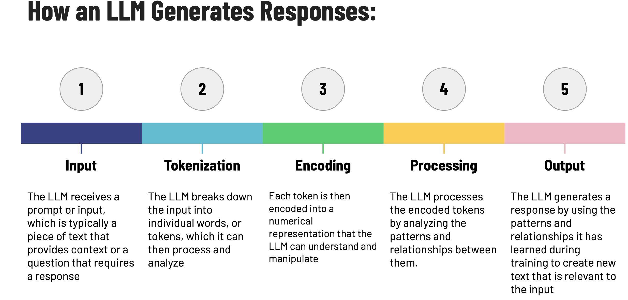
Large Language Models
Notes:
We will explore how an LLM generates responses and gains insights into the process of language understanding and generation.
1. Input:
A Large Language Model (LLM) receives a prompt or input, which could be a question, a statement, or any piece of text that provides context for the response.
2. Tokenization:
The LLM breaks down the input into individual words or tokens, dividing the text into manageable units for further processing.
3. Encoding:
Each token is then encoded into a numerical representation, converting words into numerical vectors that the LLM can understand and manipulate.
4. Processing:
The LLM processes the encoded tokens, analyzing the patterns and relationships between them.
During pre-training, the model learns complex language structures and semantic associations, which are used in later stages.
5. Output:
Based on the learned patterns and relationships, the LLM generates a response that is relevant to the input.
The response is created by employing its language understanding to generate new text that aligns with the context and intent of the input.

Slide 16
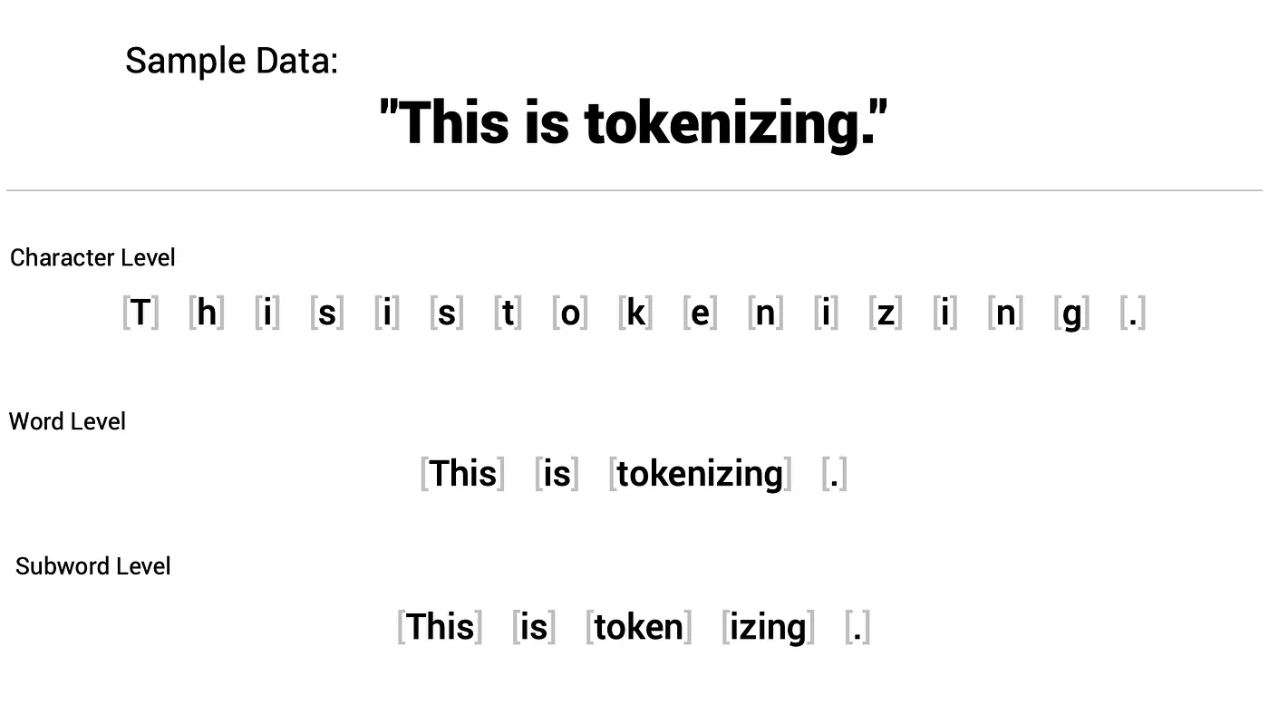
Tokenization
Breaking down textual inputs into individual units called tokens.
advisable to be mindful of token usage when making requests to language models
Three kinds of Tokenization.
Well-known models like GPT family, LLaMA employ Subword level tokenization method
Notes:
We will explore the process of breaking down textual inputs into individual units called tokens and the different kinds of tokenization methods used in language models.
1. Understanding Tokenization
Tokenization is the process of representing raw text in smaller units called tokens. These tokens are often then represented as numbers, which are essentially IDs mapping back to the token. This collection of tokens corresponds to a length of the text and often gets further encoded to be represented by a vector.
2. Importance of Token Usage
When making requests to language models, it is essential to be mindful of token usage due to limitations in model context length.
For instance, the GPT-3.5 model has a context length of 4096 tokens, covering both the tokens in the prompt and the subsequent completion.
Being aware of token usage helps ensure that the input stays within the model's context constraints.
3. Three Kinds of Tokenization
There are three primary types of tokenization used in language models:
a. Word Level
This is the standard way to tokenize the text and it’s the most intuitive. You just split up your text based on whitespace. Models such as Word2Vec and GloVe rely on word-level tokenization. The biggest drawback with this approach is that any words that didn’t show up in the training data are unknown to the model and represented with a <UNK>. We may have the word tokenization in our vocabulary, but we’re out of luck if we encounter tkenization.
b. Character Level
How about instead of creating tokens by words, we use characters? That way when we encounter a word outside of our vocabulary, we don’t need to represent it with an <UNK>, but we can use our understanding of the characters in the word to represent it. One of the first context-aware embedding methods ELMo did just that. Unfortunately, the large number of tokens required to represent a sequence of text combined with the fact that a character by itself carries no meaning results in suboptimal performance.
c. Subword Level
Subword level tokenization breaks down a word into smaller chunks when possible.
For example, the word "basketball" can be encoded as the combination of two tokens: "basket" + "ball."
Finally, subword tokenization--the best of both worlds. The word nauseant may not be in our vocabulary, but nausea likely is, and therefore we have some understanding that nauseant is an agent that induces nausea. We get to have a reasonable vocabulary size and try to process unseen words. There are several types of subword tokenization that are used by the best performing language models:
CharBPETokenizer: The original BPE
ByteLevelBPETokenizer: The byte-level version of the BPE
SentencePieceBPETokenizer: A BPE implementation compatible with the one used by SentencePiece
BertWordPieceTokenizer: The famous Bert tokenizer, using WordPiece
Tokenization is a crucial preprocessing step in language modeling, enabling efficient text processing and analysis. The choice of tokenization method depends on the specific language and task requirements.

Slide 17
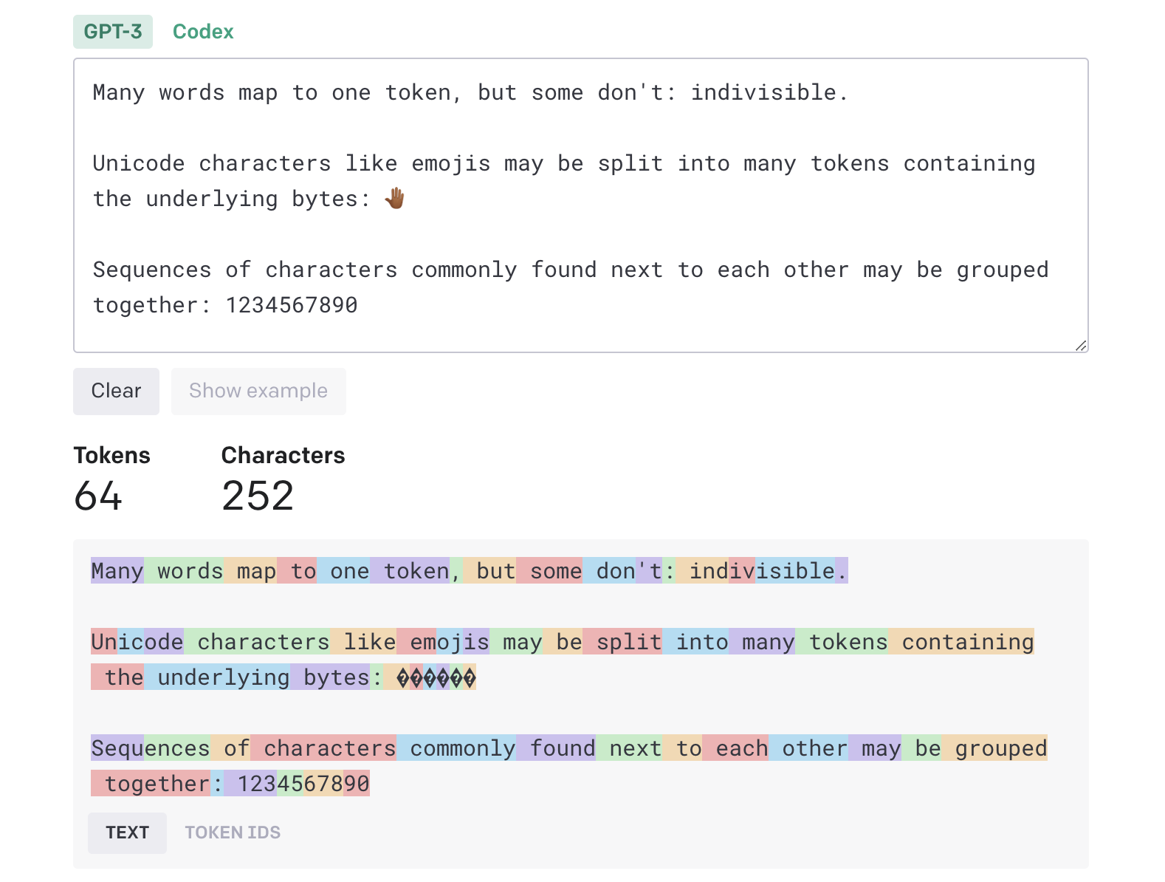
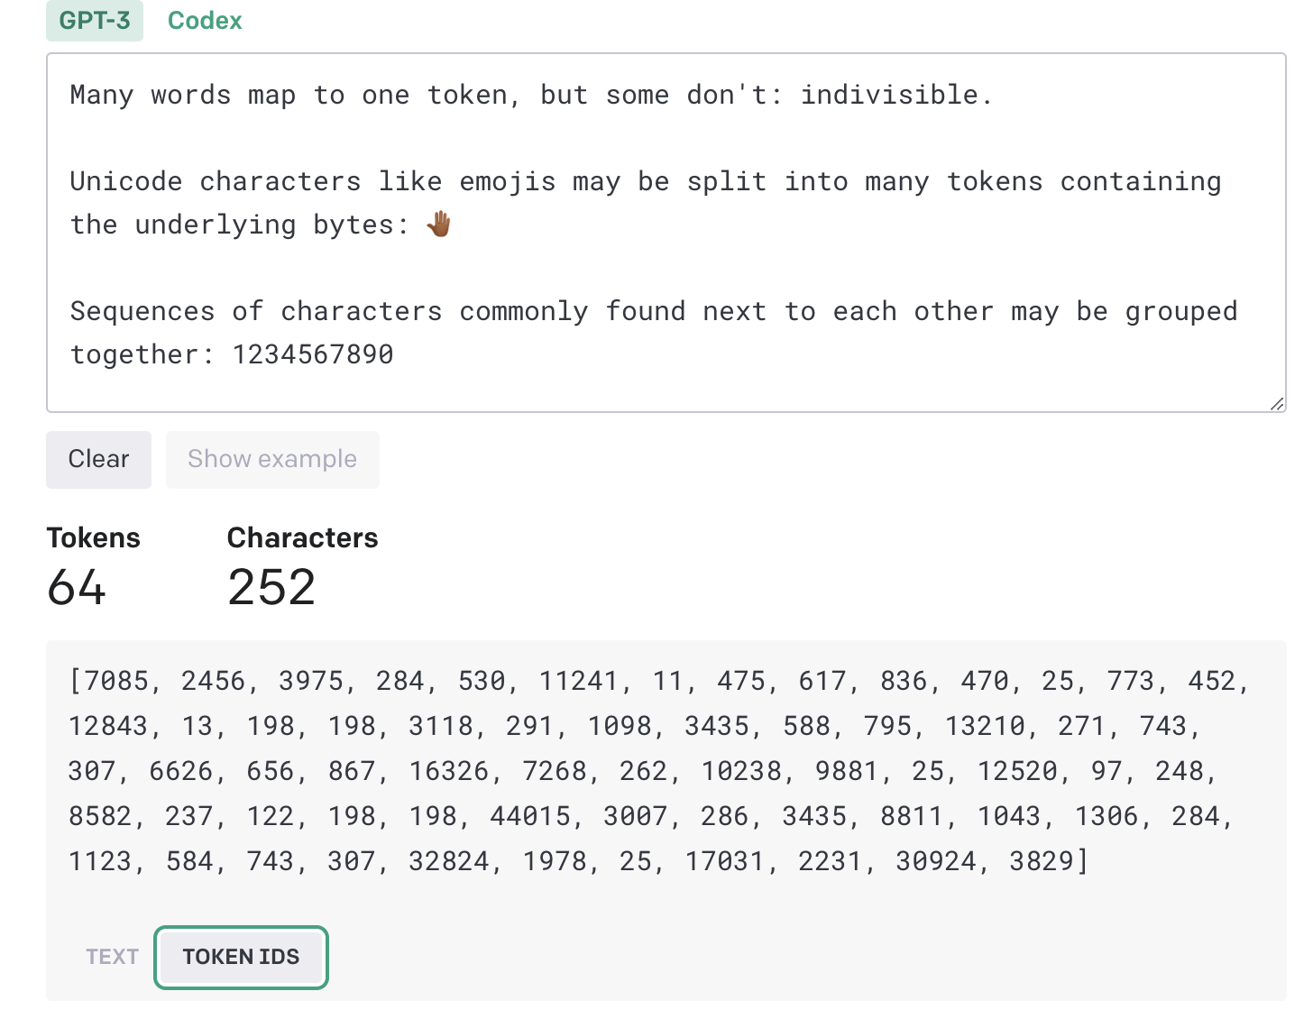
Chat gpt tokenizer
https://platform.openai.com/tokenizer
Notes:
We will explore the Chat GPT Tokenizer's role in data compression and vocabulary creation, essential steps in language model processing.
1. Data Compression Algorithm
The Chat GPT Tokenizer functions as a data compression algorithm that efficiently processes textual data.
It iteratively identifies and extracts the most repetitive words or subwords present in a given corpus.
2. Vocabulary Creation
The next step in the Tokenizer's process involves creating the vocabulary for the language model.
The vocabulary is a collection of unique words and subwords encountered in the corpus.
3. Lookup Table
After creating the vocabulary, the Tokenizer generates a lookup table to facilitate efficient encoding and decoding of the text.
The lookup table helps locate each word or subword in the dictionary and its corresponding encoded value.
The Chat GPT Tokenizer plays a pivotal role in preparing textual data for language modeling tasks. By efficiently compressing data and creating a vocabulary with a lookup table, it enables the language model to process and understand the text more effectively.

Slide 18
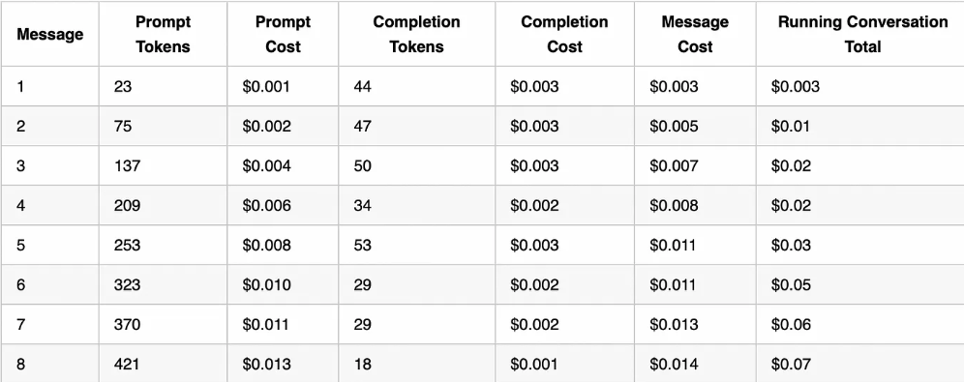
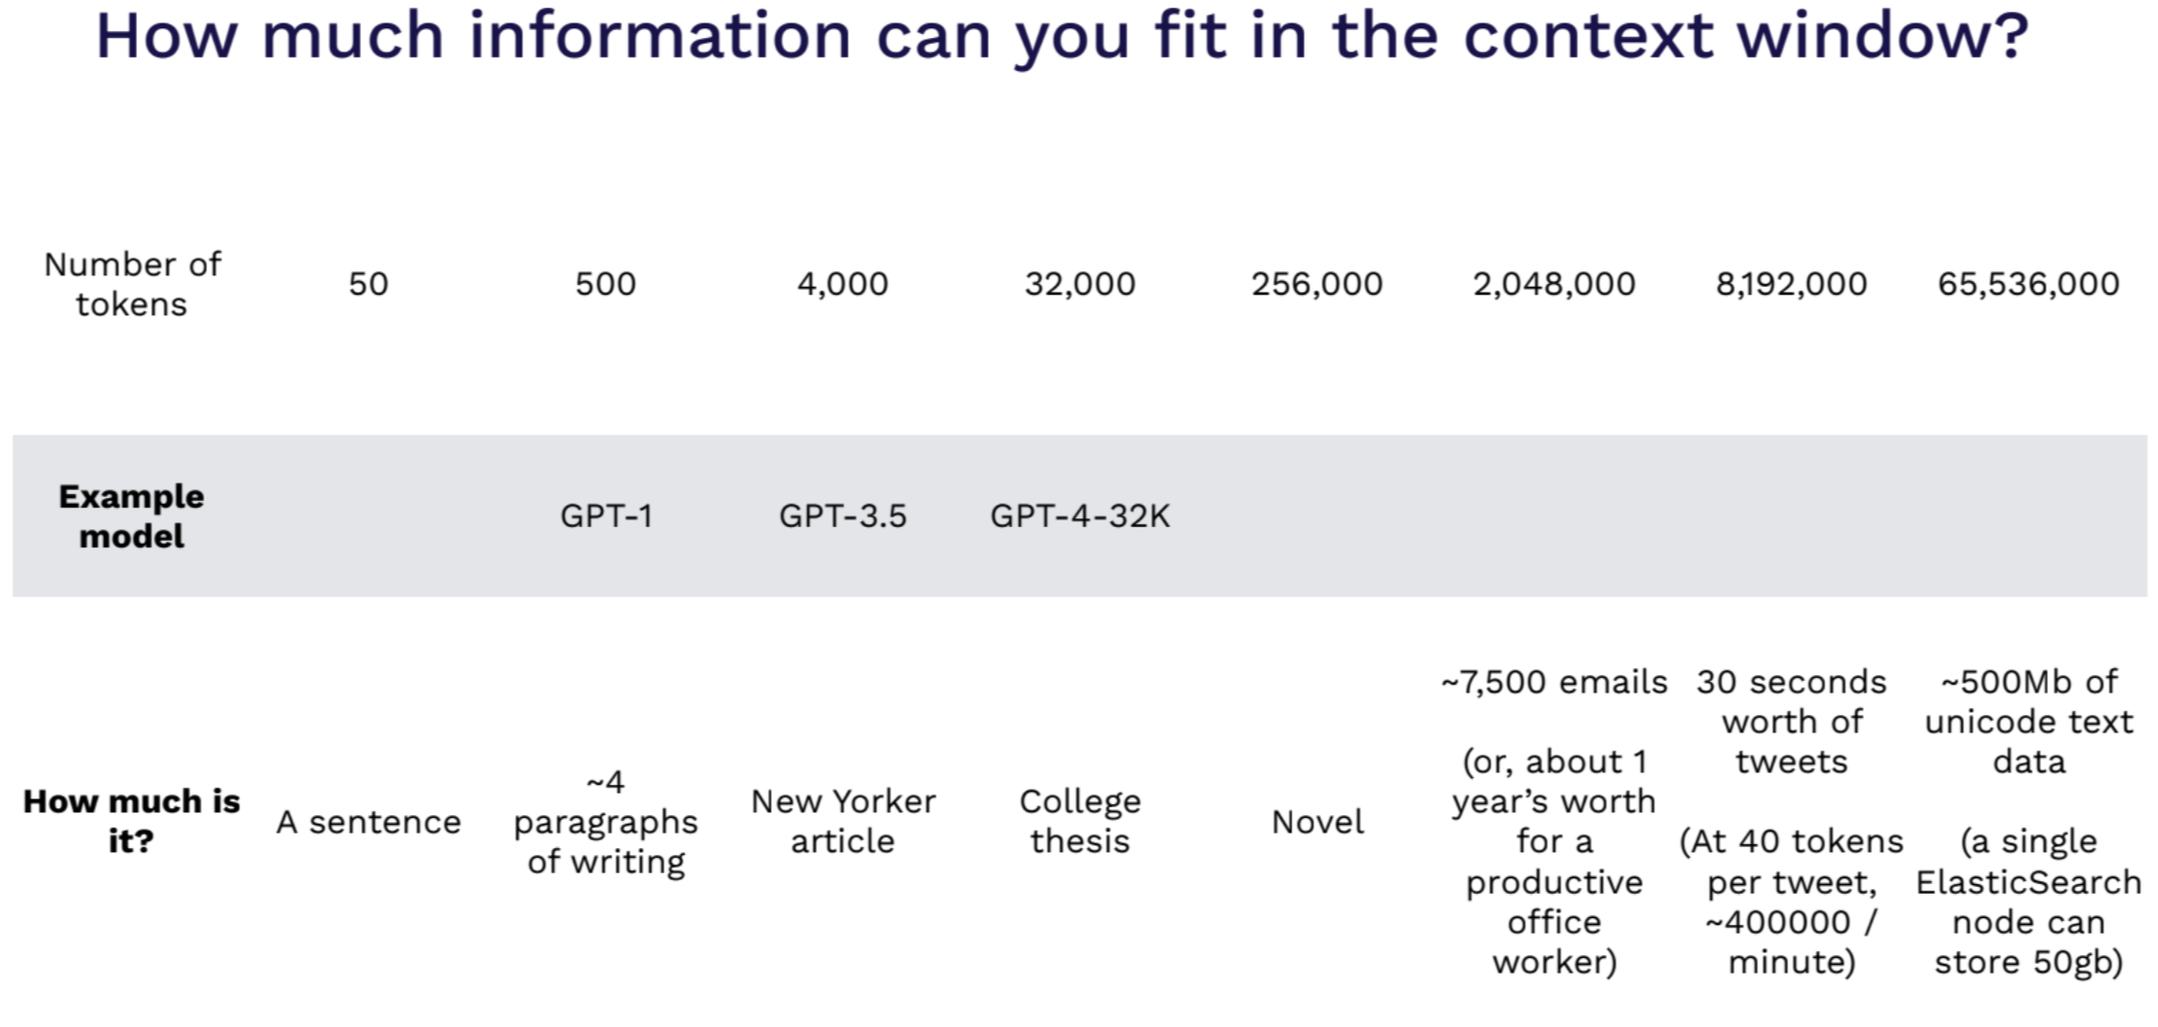
Why are tokens important?
Cost Perspective.
Context Window Size
Notes:
We will explore the impact of tokens on the cost of using AI models like GPT-4 through an API and the importance of the context window in managing conversation flow and costs.
1. Token Costs in AI Conversations
When using an AI model like GPT-4 through an API, both questions (prompts) and answers (completions) have associated costs based on the number of tokens they contain. The more tokens, the higher the cost. For instance, with GPT-4, using the API currently entails a cost of $0.03 for every 1000 tokens in the question and $0.06 for every 1000 tokens in the answer. On the other hand, ChatGPT Plus subscribers are not limited by tokens but rather by message count. At the time of writing, ChatGPT Plus subscribers have a limit of 25 messages every 3 hours. Table 1 provides a detailed breakdown of token costs in this basic conversation. As the conversation progresses, the total cost increases due to the accumulation of tokens in both prompts and completions. For example, note how the last comment thanking the AI has the largest cost with the least informational value because the entire prior history of the conversation was sent to the AI along with the Thanks.
2. Importance of Context Window
The context window, which represents the AI’s memory limit for a single conversation, may also play a role in determining costs. If a conversation exceeds the context window, the AI may “forget” earlier parts, affecting the conversation’s flow and potentially increasing token usage by requiring users to resubmit information.
Understanding token costs in AI conversations and draft revisions is crucial for efficient and cost-effective AI model interactions. By following the tips and strategies outlined in this article, users can optimize their AI interactions and API usage, ultimately saving time and money.

Slide 19
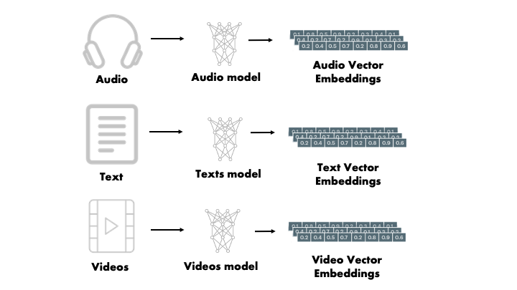
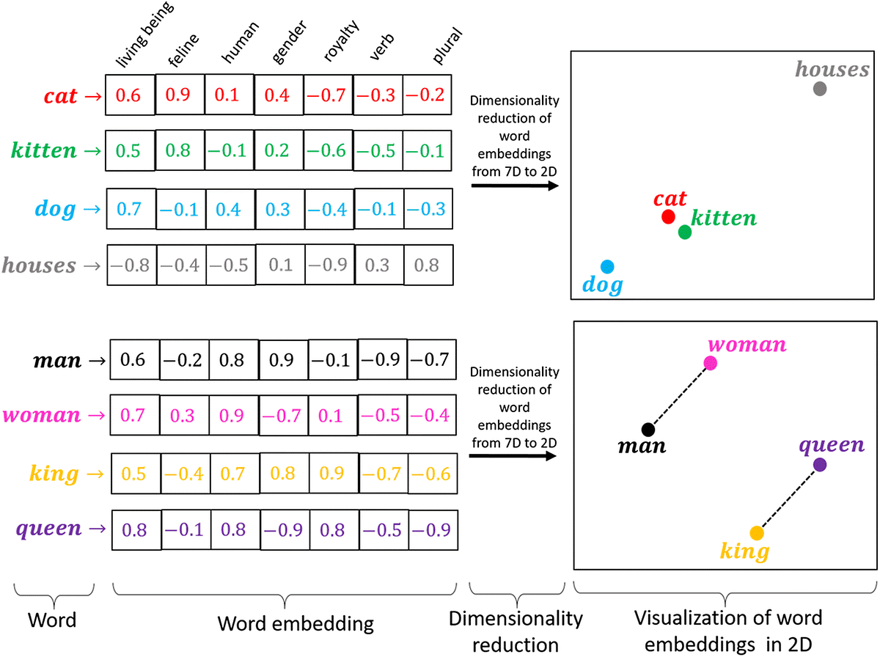
Vector Embeddings
Used to convert data into an easy format for computers to understand. Those formats are Vector Embeddings.
Do Custom Embeddings work better as opposed to using off the shelf LLM embeddings?
Notes:
We will explore the concept of vector embeddings, their role in converting data into a computer-readable format, and the comparison between custom embeddings and off-the-shelf LLM embeddings.
1. Understanding Vector Embeddings
Vector embeddings are representations used to convert data into a format that is easily understandable by computers.
These embeddings transform raw data, such as text, audio, or videos, into dense numerical vectors with semantic meaning, facilitating efficient analysis and processing.
2. Custom vs. Off-the-Shelf LLM Embeddings
A common question arises: Do custom embeddings work better than using off-the-shelf Large Language Model (LLM) embeddings?
Custom embeddings are tailored to specific tasks and data, potentially providing better performance for niche domains.
Off-the-shelf LLM embeddings, on the other hand, offer generalization and convenience but may lack fine-tuning for specific applications.
3. What are Vector Embeddings?
Vector embeddings are numerical representations that capture the semantic meaning of data.
For legacy vectorizing techniques, examples like CountVectorizer and Bag of Words are used to convert text into numerical vectors, representing word frequencies or presence in documents.
[Slide Images:]
Image 1: Demonstrates the use of vector embeddings for different data types like audio, text, and videos.
Vector embeddings are quite flexible. Audio, video, text, and images can all be represented as vector embeddings. This quality makes vector embeddings the swiss-army knife of the data scientist’s toolkit.
Image 2: Illustrates the process of word embeddings, dimensionality reduction, and visualization of word embeddings in 2D space.
Word -> Word embedding -> Dimensionality reduction -> Visualization of word embeddings in 2D
Word: The process starts with individual words being transformed into Word Embeddings. Word Embeddings are dense numerical representations that capture the semantic relationships between words based on their context and usage.
Dimensionality Reduction: The next step involves dimensionality reduction techniques such as Principal Component Analysis (PCA) or t-distributed Stochastic Neighbor Embedding (t-SNE). These techniques reduce the high-dimensional word embeddings into a lower-dimensional space, making it easier to visualize and interpret.
Visualization: The final outcome is the visualization of word embeddings in a 2D space. Words with similar meanings or contextual associations tend to cluster together in this 2D representation. The visualization provides insights into semantic relationships between words, helping understand their semantic proximity and associations.

Slide 20
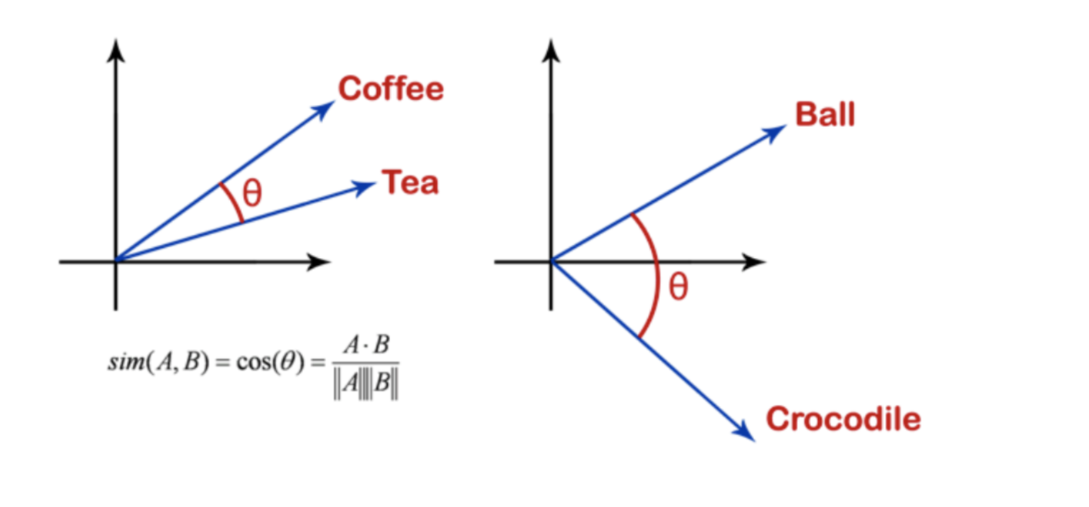
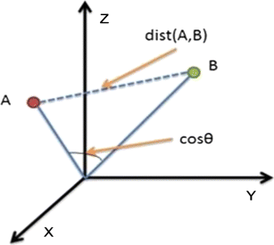
Similarity Measures
Similarity measures allow you to quantify semantic relationships between two entities.
Cosine Similarity: Popular for Dense vectors like NLP use cases. Measures angles between them
Euclidean distance
Manhattan Distance
Core Idea: Similar things closer,
Not similar far
Notes:
We will explore the concept of similarity measures and their role in quantifying semantic relationships between entities. We will also discuss some popular similarity measures used in various applications.
1. Understanding Similarity Measures
Similarity measures are mathematical methods used to quantify the semantic relationships between two entities, such as vectors or data points.
These measures help in comparing the similarity or dissimilarity between entities, providing insights into their relationships.
2. Cosine Similarity
Cosine similarity is a popular measure, especially for dense vectors used in Natural Language Processing (NLP) and other applications.
It measures the cosine of the angle between two vectors, indicating how similar their orientations are.
Cosine similarity ranges from -1 to 1, where -1 represents completely opposite directions, 1 represents identical directions, and 0 represents orthogonal or perpendicular vectors.
3. Euclidean Distance
Euclidean distance is a metric that measures the straight-line distance between two data points in a given space.
It is calculated as the square root of the sum of the squared differences between corresponding elements of the vectors.
Euclidean distance is commonly used in applications where the magnitude of the difference between entities is crucial.
4. Manhattan Distance
Manhattan distance, also known as taxicab distance or L1 distance, calculates the distance between two points by summing the absolute differences between their corresponding elements.
It measures the distance traveled along axis-aligned paths, like moving through city blocks.
Manhattan distance is useful in applications where the path's direction matters more than the actual distance.

Slide 21
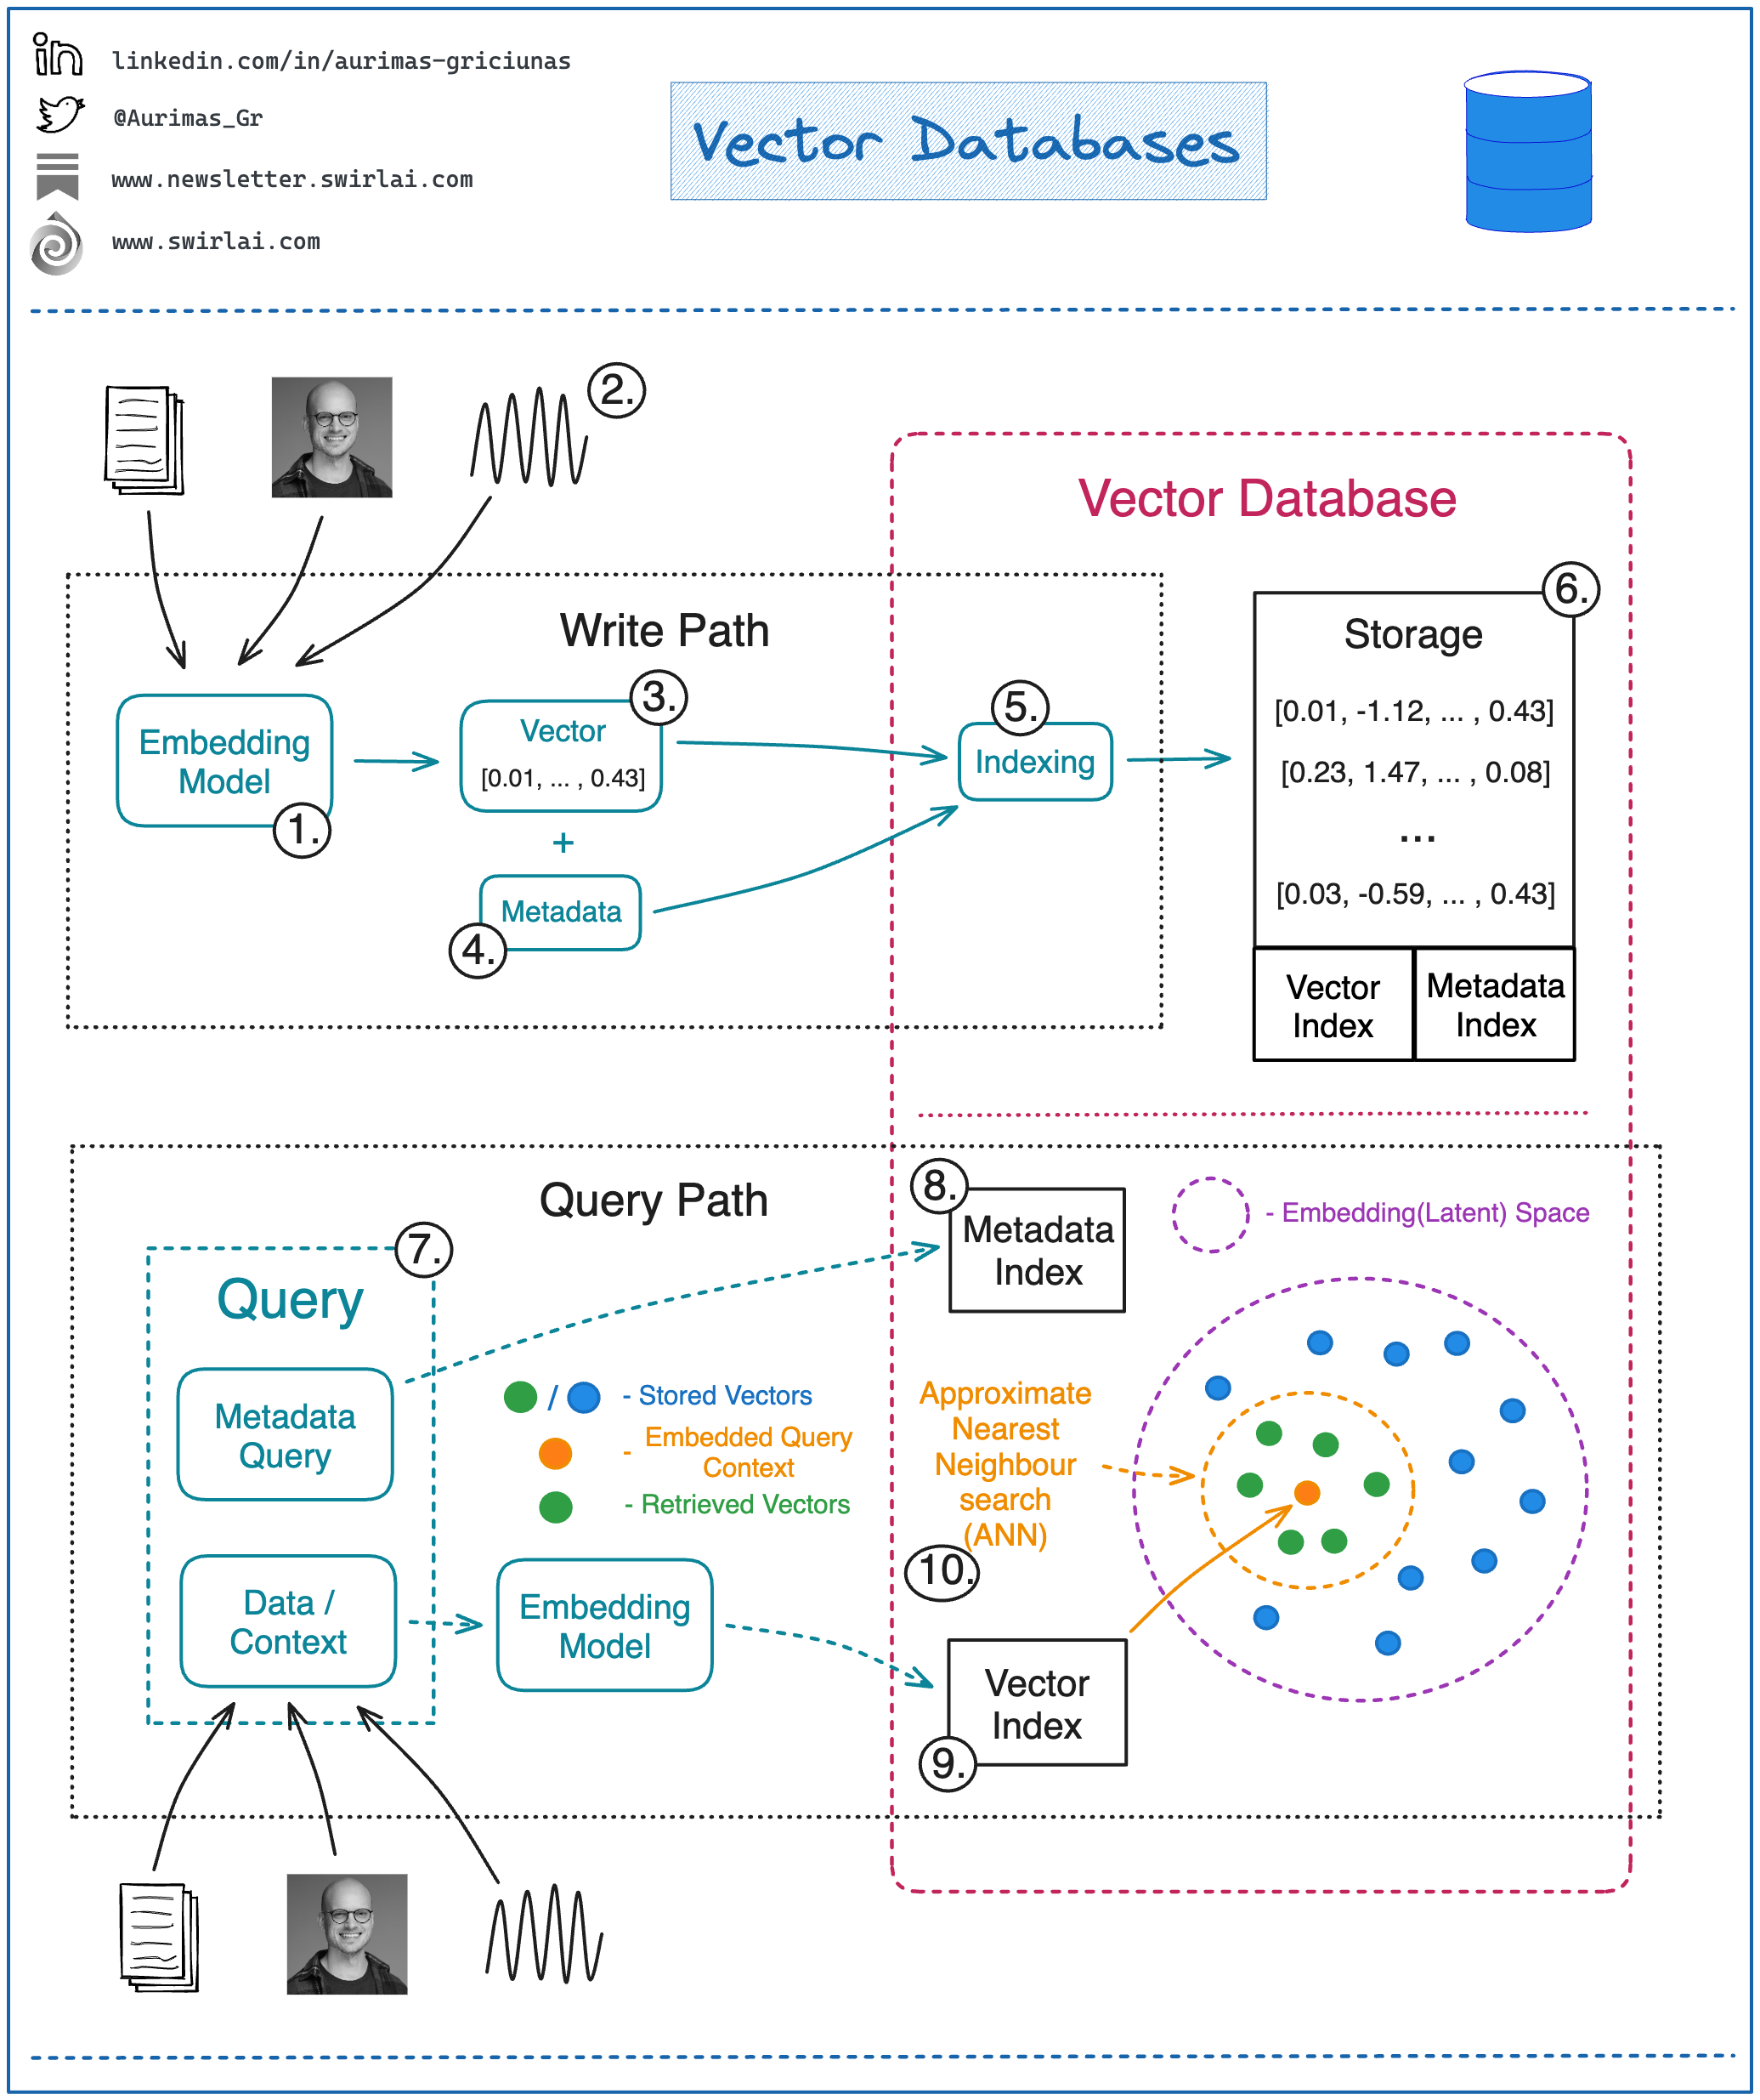
Vector Databases
Designed to enable fast and efficient similarity search in high-dimensional vector spaces.
Serve as a bridge between the offline training of models and the online results serving.
Provide a scalable solution for storing and retrieving large amounts of high-dimensional vector data.
Notes:
We will discuss how vector databases work and their significance in bridging the gap between offline model training and online results serving.
1. Understanding Vector Databases
Vector databases are specialized databases designed to handle high-dimensional vector data efficiently.
They serve as repositories for storing and retrieving large amounts of vector data, facilitating similarity search and analysis.
2. How Vector Databases Work
Vector databases leverage advanced indexing and search techniques to enable fast and accurate similarity search in high-dimensional spaces.
They organize and index vector data in a manner that optimizes similarity queries, reducing the computational overhead and improving search efficiency.
3. Bridging Offline Training and Online Serving
Vector databases act as a bridge between the offline training phase of machine learning models and the online results serving phase.
During training, vector embeddings are generated and stored in the database.
In the online serving phase, similarity search is performed on the stored embeddings to find the most relevant results for a given query.
4. Scalable Solution for Large Datasets
Vector databases provide a scalable solution for managing and handling large volumes of high-dimensional vector data.
They can efficiently handle datasets with millions or even billions of vectors, making them suitable for real-world applications.
A query here could be in a form of an object like an image for which we would like to find similar images. Or it could be a question for which we want to retrieve relevant context that could later be transformed into an answer via e.g. a Large Language Model.
Let’s look into how one would interact with a regular Vector Database:
𝗪𝗿𝗶𝘁𝗶𝗻𝗴/𝗨𝗽𝗱𝗮𝘁𝗶𝗻𝗴 𝗗𝗮𝘁𝗮.
Choose a ML model to be used to generate Vector Embeddings.
Embed any type of information: text, images, audio, tabular. Choice of ML model used for embedding will depend on the type of data.
Get a Vector representation of your data by running it through the Embedding Model.
Store additional metadata together with the Vector Embedding. This data would later be used to pre-filter or post-filter ANN search results.
Vector DB indexes Vector Embedding and metadata separately. There are multiple methods that can be used for creating vector indexes, some of them being: Random Projection, Product Quantization, Locality-sensitive Hashing.
Vector data is stored together with indexes for Vector Embeddings and metadata connected to the Embedded objects. 𝗥𝗲𝗮𝗱𝗶𝗻𝗴 𝗗𝗮𝘁𝗮.
A query to be executed against a Vector Database will usually consist of two parts: Data that will be used for ANN search. e.g. an image for which you want to find similar ones. Metadata query to exclude Vectors that hold specific qualities known beforehand. E.g. given that you are looking for similar images of apartments - exclude apartments in a specific location.
You execute Metadata Query against the metadata index. It could be done before or after the ANN search procedure.
You embed the data into the Latent space with the same model that was used for writing the data to the Vector DB.
ANN search procedure is applied and a set of Vector embeddings are retrieved. Popular similarity measures for ANN search include: Cosine Similarity, Euclidean Distance, Dot Product.
Some popular Vector Databases: Pinecone, Weviate, Milvus, Faiss, Vespa.

Slide 22
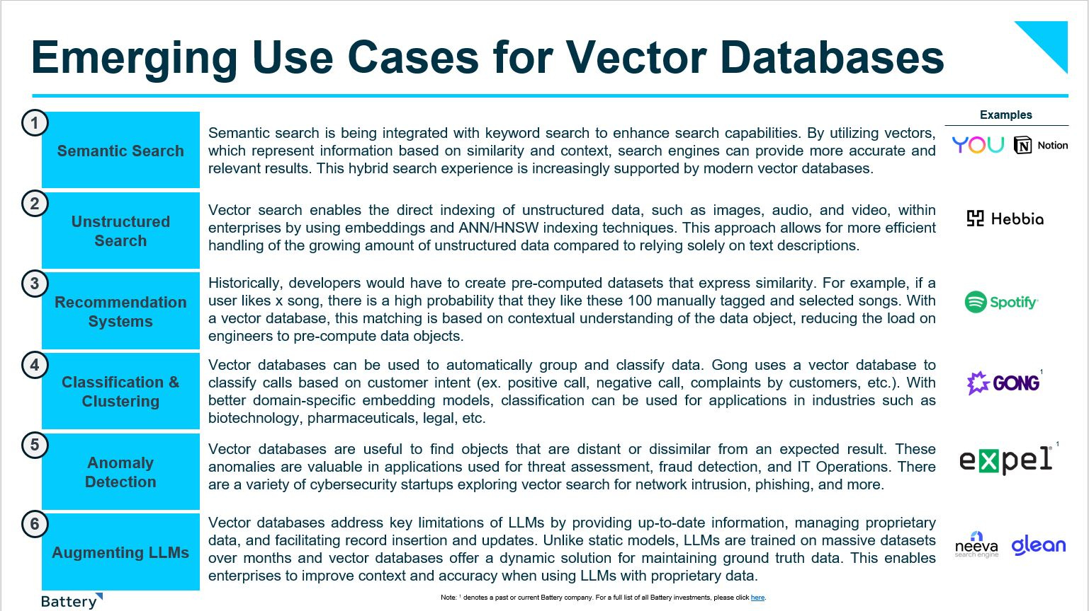
Vector Databases
https://batteryventures.substack.com/p/developer-centric-ai-vector-databases
Notes:
While vector databases were originally developed to address needs of large-scale personalization, recommendation and semantic search/retrieval engines, today we’ve seen new use cases emerge around data clustering, anomaly detection and proprietary data retrieval—with real-world applications in sectors as varied as Internet search, sales analysis and cybersecurity.
As the volume of unstructured data continues to expand, vector databases play an increasingly critical role in enabling users to search through relationships, context and meaning. Many of these use cases aren’t necessarily new and have been solved in the past with retrieval and search systems such as Elasticsearch, OpenSearch, Solr and Lucene. But simply supporting different indexing libraries on rigid data models that don’t support CRUD operations and store raw data objects and metadata with vectors isn’t enough. In a data-driven world, enterprises want to maintain control of their proprietary data, and vector databases serve as a critical component to enable better model creation with proprietary use case/domain-specific data.

Slide 23
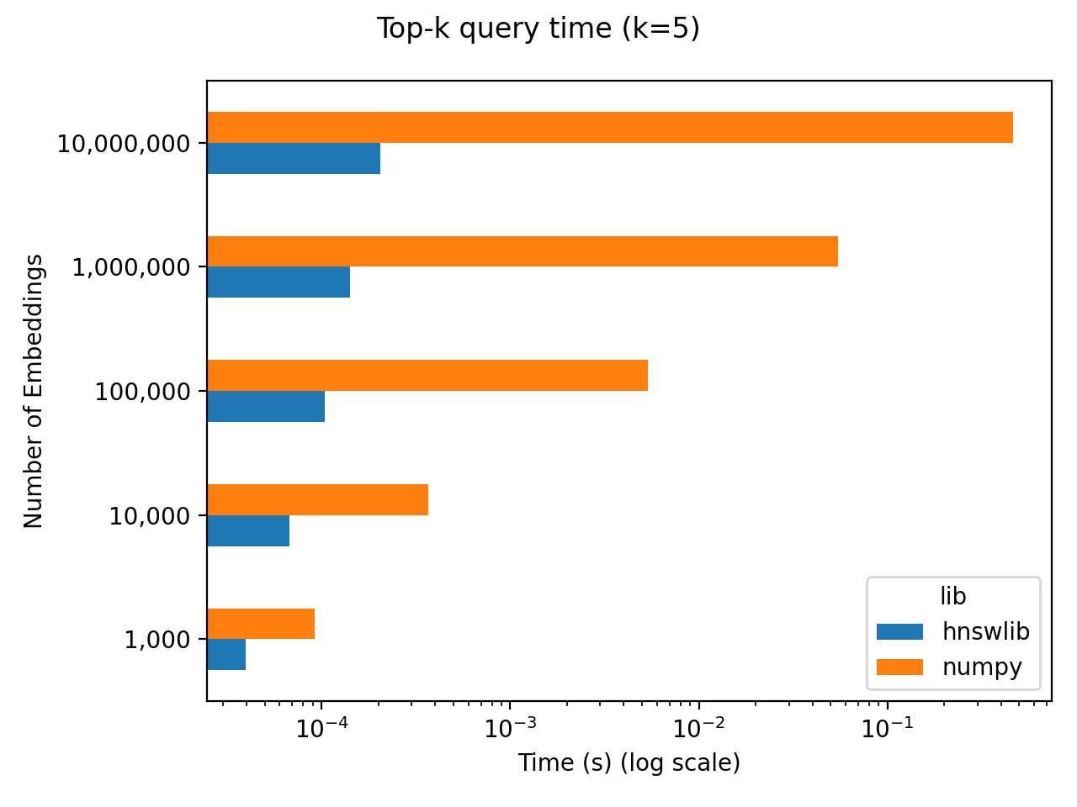
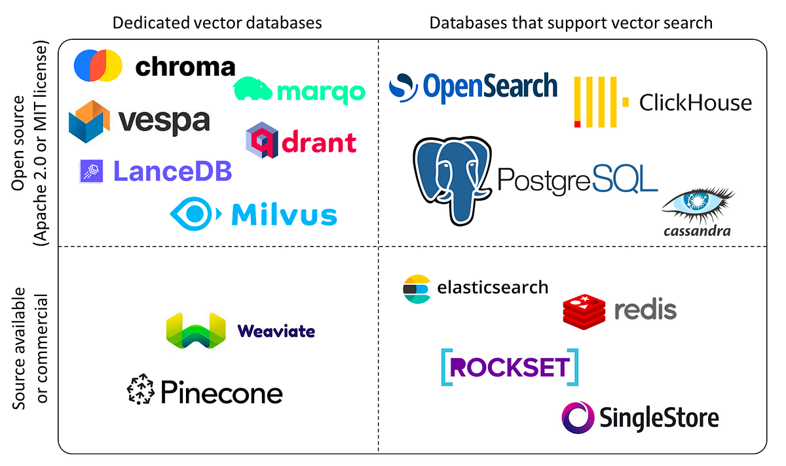
To use or not: vector Databases?
For less than 100K embeddings, use Numpy with object storage.
When your need is to search full text and semantic search, use a database that supports both.
If embedding > 100k, Elasticsearch is battle-tested and supports keyword search, metadata filtering, and semantic search.
But you would want to see what your organization uses. You may be already using one. Eg. Redis, postgres
https://www.ethanrosenthal.com/2023/04/10/nn-vs-ann/
Notes:
We will explore the considerations and options for choosing the right vector database based on the size of embeddings and specific search requirements. Let's discuss the different scenarios for using vector databases.
1. Less Than 100K Embeddings
For datasets containing less than 100K embeddings, a combination of Numpy with object storage can be a viable option.
Numpy, a Python library for numerical computing, offers efficient data structures for handling smaller datasets.
Object storage provides a scalable solution for storing and accessing embeddings while keeping the data organized.
The results are shown in both axes on log scales. It’s hard to see when we’re dealing with log-log scales, but numpy scales linearly with N. The latency is roughly 50 milliseconds per million embeddings. Again, depending on your N and latency requirements, 50 ms for 1 million embeddings might be perfectly fine! Additionally, you get to save yourself the complication of standing up a vector database and waiting the ~100 seconds to index those million embeddings.
2. Full Text and Semantic Search
When the need arises for both full-text and semantic search capabilities, a database that supports both functionalities is ideal.
Such databases are designed to handle text-based queries and similarity searches efficiently.
3. Embeddings > 100K: Elasticsearch
For datasets with embeddings exceeding 100K, Elasticsearch is a battle-tested option.
Elasticsearch is a popular search and analytics engine that supports keyword search, metadata filtering, and semantic search.
It is well-suited for handling large-scale datasets and can efficiently perform similarity searches in high-dimensional spaces.
4. Consider Existing Solutions
It's essential to consider the existing database solutions used within your organization.
Some organizations may already be using databases like Redis or Postgres, which can also handle vector data efficiently.
Leveraging existing solutions can streamline integration and reduce operational complexity.
Choosing the right vector database depends on the size of your embeddings, specific search requirements, and the existing database infrastructure within your organization. Numpy with object storage can work for smaller datasets, while Elasticsearch is a robust choice for larger-scale similarity searches.

Slide 24
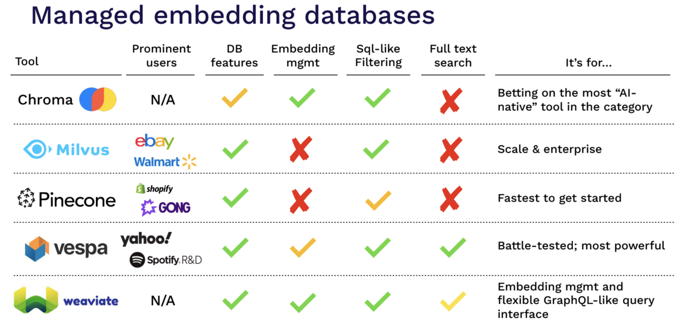
When to use vector Databases?
For very specialized
use cases like Multimodal
Search use a dedicated vector DB.
If Existing DBs like Elasticsearch, pgvector, redis are not performing well.
Vespa is open source, supports full text search and highly scalable.
From Josh Tobin’s FSDL LLM 2023
Notes:
We will explore the scenarios and considerations for utilizing dedicated vector databases. Let's discuss when it's suitable to opt for a dedicated vector database over existing solutions.
1. Specialized Use Cases: Multimodal Search
For very specialized use cases, especially those involving Multimodal Search, a dedicated vector database becomes an excellent choice.
Multimodal Search deals with various types of data, such as text, images, audio, and videos, enabling more comprehensive and intelligent search capabilities.
Dedicated vector databases are designed to efficiently handle diverse data types and perform complex similarity searches across these modalities.
2. Performance Issues with Existing DBs
If existing databases like Elasticsearch, pgvector, or Redis are not meeting performance expectations for your vector-based applications, it might be time to consider a dedicated vector database.
Performance concerns may arise due to large-scale datasets, high-dimensional embeddings, or specialized requirements that existing databases struggle to
3. Vespa: Open Source and Highly Scalable
Vespa is an open-source, highly scalable search and serving engine designed to handle complex search tasks, including vector-based queries.
It supports full-text search as well as similarity searches in high-dimensional vector spaces, making it suitable for diverse applications.
Vespa's scalability allows it to handle large datasets and serve real-time responses efficiently.

Slide 25

How to search on Custom Data
LLMs don’t know your Data.
Custom LLMs can be expensive to create.
You can add it to prompt. But what if we have large amounts of data.
Enter Retrieval Augmented search and generation
Notes:
1. LLMs and Custom Data
Large Language Models (LLMs) possess immense capabilities but are unaware of the specifics of your custom data.
Creating a custom LLM tailored to your data can be a resource-intensive and expensive process.
2. Challenges of Adding Custom Data to Prompts
One approach to incorporate custom data is by adding it to the prompt fed to the LLM.
However, this becomes cumbersome when dealing with large volumes of data, leading to impractical prompt lengths and inefficient searches.
3. Enter Retrieval Augmented Search and Generation
Retrieval Augmented search and generation is an advanced technique that addresses the challenges of searching on custom data.
It combines the power of traditional LLMs with the efficiency of retrieval-based models.
By using a dedicated vector database, such as Vespa or Elasticsearch, custom data can be indexed for fast and accurate similarity search.
The LLM generates relevant results by querying the vector database, utilizing the information encoded in the custom data.
Searching on custom data with LLMs can be challenging due to the model's lack of data awareness and the complexity of managing large volumes of data in prompts. Retrieval Augmented search and generation offer a powerful solution by leveraging vector databases and combining the strengths of retrieval-based models and LLMs.

Slide 26
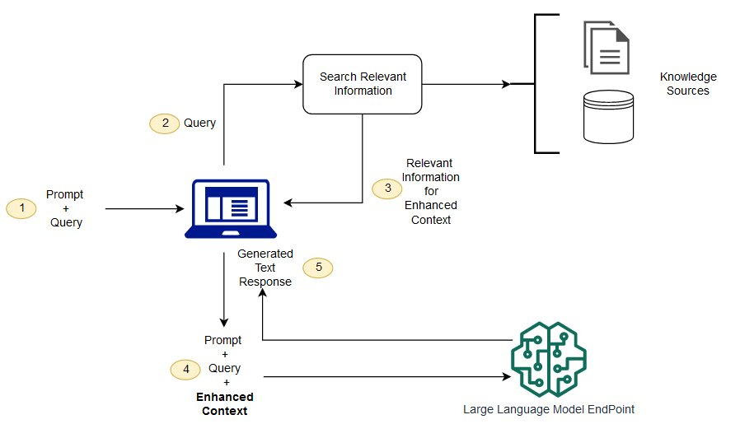
Retrieval Augmented Generation
It combines the best of retrieval-based and generative methods in NLP to answer questions or search queries.
It has 3 parts
Query Understanding
Document Retrieval
Answer Generation
Pros
Reduced Hallucination.
Increased Accuracy
Verifiable Information
Cons
Limited scope
Dependence on document quality.
Inability to eliminate hallucination completely*
* LLM behavior also changes over time.
Notes:
We will explore this powerful approach that combines the strengths of retrieval-based and generative methods in Natural Language Processing (NLP) to answer questions and search queries. Let's dive into its components, pros, and cons.
1. What is Retrieval Augmented Generation?
Retrieval Augmented Generation (RAG) is an advanced NLP technique that fuses retrieval-based and generative methods to address complex language tasks effectively.
It aims to provide more accurate and verifiable information while reducing the problem of hallucination, where generated text contains false or incorrect information.
2. Components of RAG: With RAG, the external data used to augment your prompts can come from multiple data sources, such as a document repositories, databases, or APIs. The first step is to convert your documents and any user queries into a compatible format to perform relevancy search. To make the formats compatible, a document collection, or knowledge library, and user-submitted queries are converted to numerical representations using embedding language models. Embedding is the process by which text is given numerical representation in a vector space. RAG model architectures compare the embeddings of user queries within the vector of the knowledge library. The original user prompt is then appended with relevant context from similar documents within the knowledge library. This augmented prompt is then sent to the foundation model. You can update knowledge libraries and their relevant embeddings asynchronously.
3. Pros of RAG:
Reduced Hallucination: RAG reduces the tendency of generated text to contain false or irrelevant information.
Increased Accuracy: By combining retrieval-based and generative approaches, RAG provides more accurate and contextually relevant answers.
Verifiable Information: RAG's reliance on retrieved documents ensures that generated answers are based on existing information in the corpus.
4. Cons of RAG:
Limited Scope: RAG's performance is limited by the quality and scope of the available documents in the retrieval process.
Dependence on Document Quality: The effectiveness of RAG depends on the quality and relevance of documents retrieved.
Inability to Eliminate Hallucination Completely: While RAG reduces hallucination, it may not completely eliminate it, as generative models can still produce fictional or speculative responses.
Retrieval Augmented Generation combines the best of retrieval-based and generative NLP techniques, enabling more accurate, verifiable, and contextually appropriate responses. However, it comes with certain limitations based on document quality and the inherent nature of generative models.

Slide 27
Steps from RAG to Riches
Document Loading
Document Splitting
Generating Vector Embeddings
Retrieval
Notes:
We will explore the key steps involved in the Retrieval Augmented Generation (RAG) process, along with the pros and cons of using a source document to enhance the generation of content. Let's delve into the steps and their implications.
1. Document Loading:
The first step is loading the source document, which serves as the basis for the generation process.
The source document provides context and information for the Large Language Model (LLM) to generate content that aligns with the given information.
2. Document Splitting:
The source document may contain multiple sections or paragraphs. Document splitting involves breaking down the document into smaller chunks or segments, which can be utilized for context-specific generation.
3. Generating Vector Embeddings:
Once the source document and its segments are ready, the text data undergoes vector embedding, converting it into a format that the LLM can understand and process.
Vector embeddings enable efficient and accurate similarity searches for retrieval-based generation.
4. Retrieval:
The retrieval step involves querying the vector database with the user's query and utilizing the source document's vector embeddings to identify relevant segments for the answer generation.
The retrieved segments serve as the basis for the LLM to generate content.
Pros of Using Source Document:
Reduced Hallucination: Providing a source document reduces the chances of generating false or irrelevant information, as the LLM can refer to the given context.
Increased Accuracy: Relying on a reliable source document enhances the accuracy of generated answers, especially in use cases where precision is vital.
Verifiable Information: Users can cross-check the generated content with the source document, ensuring the accuracy and reliability of the information.
Cons of Using Source Document:
Limited Scope: Depending on a single document may limit the scope of the generated content, as the LLM has access only to the information within the document.
Dependence on Document Quality: The accuracy of the generated content heavily relies on the quality and reliability of the source document. Inaccurate or biased information in the document may lead to incorrect generation.
Inability to Eliminate Hallucination Completely: Although using a source document reduces hallucination, it does not guarantee the complete absence of false or irrelevant information.
The steps from RAG to riches involve loading and splitting the source document, generating vector embeddings, and utilizing retrieval-based generation to enhance the content generation process. While using a source document provides benefits like reduced hallucination and increased accuracy, it also comes with limitations concerning scope and document quality.

Slide 28
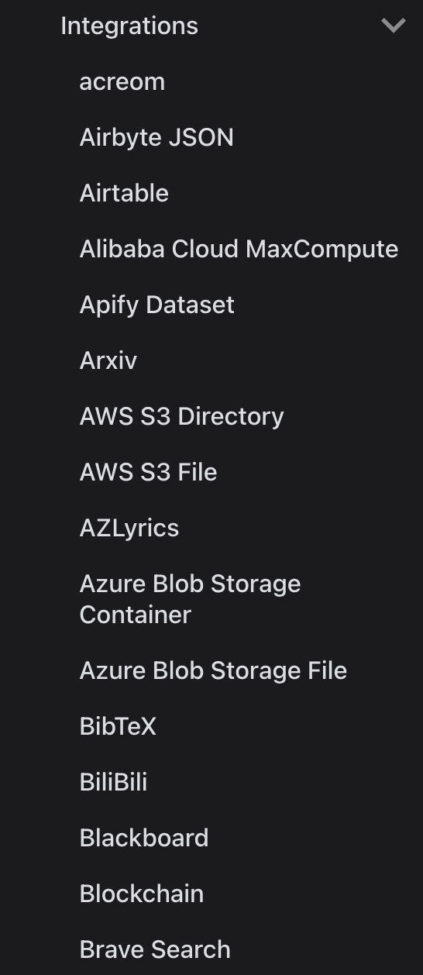
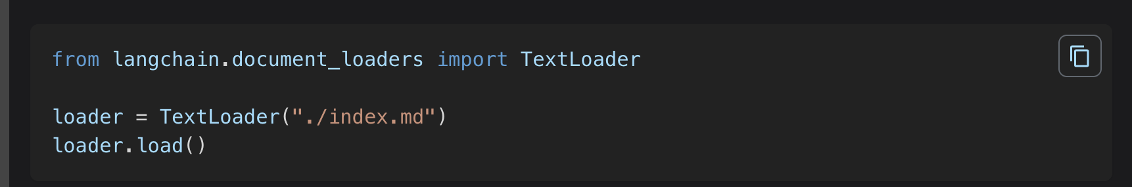
Loading the Data: Langchain
Use document loaders to load data from a source as Document’.
A wide range of integrations are available to load data.
Notes:
We will explore the essential aspect of loading data using document loaders in Langchain. Let's understand how document loaders facilitate data integration and provide a wide range of options for loading data from various sources.

Slide 29
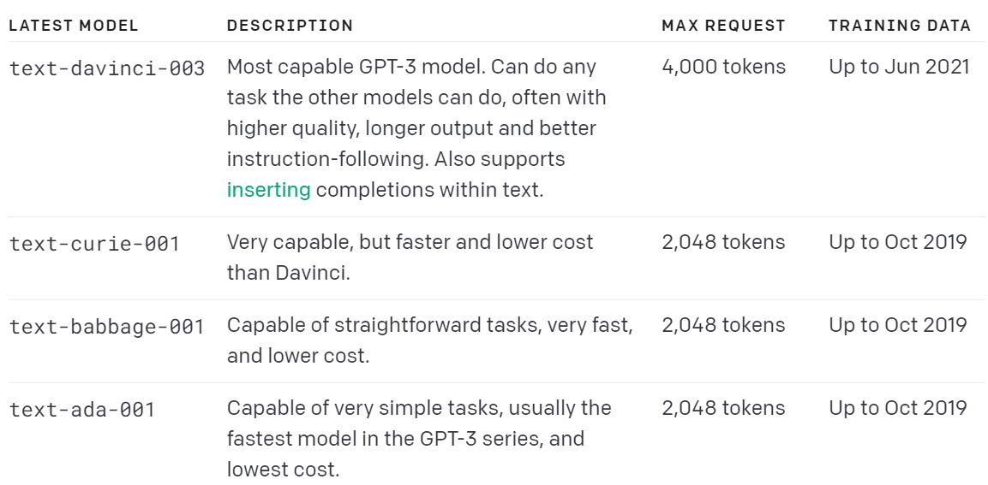
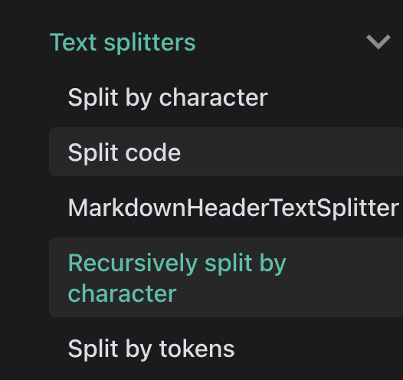
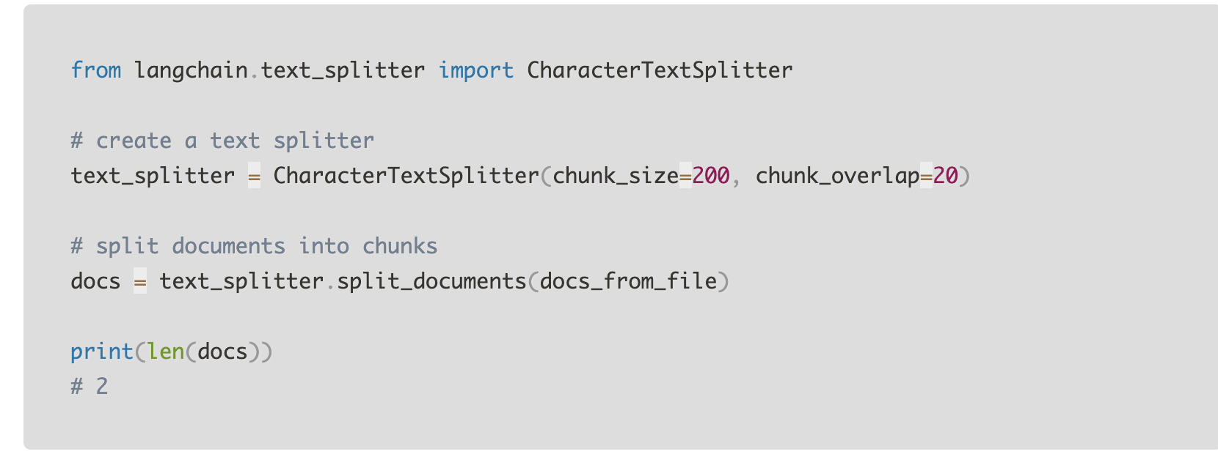
Splitting the Data
Reason For Splitting Data
Chatgpt and LLM have limits. LLMs have a maximum prompt size
Text Splitters help break down large text documents into smaller, more digestible pieces that language models can process more effectively.
Text Splitter can also improve vector store search results, as smaller segments might be more likely to match a query faster.
May require tuning by Experimenting with different chunk sizes and overlaps.
Best practice: Try to create chunks that are semantically consistent
Notes:
We will explore the importance of data splitting and how it enhances the efficiency of Language Models (LLMs) like ChatGPT. We'll also discuss various methods of data splitting and best practices to achieve optimal results.
1. Reason for Splitting Data:
LLMs and ChatGPT have limitations in terms of input size and processing capacity.
Language Models have a maximum prompt size, and data exceeding this limit cannot be processed effectively.
To address this limitation, data splitting is required to break down large text documents into smaller, more digestible pieces that can be efficiently processed by the models.
2. Types of Data Splitting:
Text Splitters are used to divide lengthy documents into smaller segments.
There are different kinds of data splitting techniques, such as:
Fixed-Length Split: Breaking the text into equal-sized chunks.
Dynamic-Length Split: Adjusting the chunk size based on content or paragraph boundaries.
Sliding Window Split: Overlapping chunks to capture context continuity.
3. Advantages of Data Splitting:
Improved Efficiency: Smaller document segments are processed more efficiently by LLMs, enabling better utilization of the model's capacity.
Enhanced Search Results: Text Splitters can improve vector store search results, as smaller segments are more likely to match queries faster.
Tuning for Optimization: Experimenting with different chunk sizes and overlaps allows optimization based on specific use cases.
Semantic Consistency: The best practice is to create chunks that are semantically consistent, ensuring coherence and relevance.
Data splitting plays a crucial role in optimizing the performance of Language Models like ChatGPT, allowing the processing of large documents and improving search results in vector stores. The choice of data splitting technique depends on the application's needs and desired performance.

Slide 30
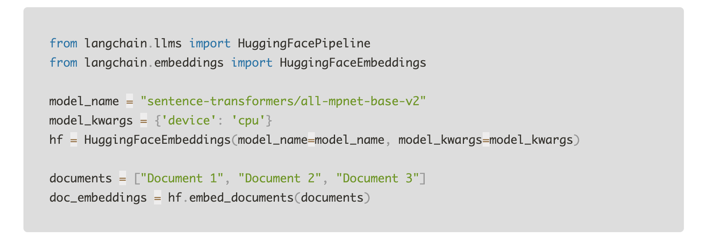
Embeddings
Dense vector representations of data that encapsulate semantic information.
Suitable for various machine-learning tasks such as clustering, recommendation, and classification.
Data type | Embedding model
Text | GPT Family, LLAMA
Images | CNN such as VGG and Inception
Audio | Spectrograms
Notes:
We will explore the concept of dense vector representations and their applications in various machine-learning tasks. We'll also discuss different data types and their corresponding embedding models that generate these dense vectors.
1. What are Dense Vector Representations?
Dense vector representations are numerical encodings that capture the semantic information of data.
These representations are suitable for various machine-learning tasks, such as clustering, recommendation, and classification.
Dense vectors are used to transform complex data types, like text, images, and audio, into a structured format that machine learning models can efficiently process.
2. Applications of Dense Vector Representations:
Dense vector representations find extensive applications in the following areas:
Text Data: NLP models like the GPT Family and LLAMA generate dense vectors that encode the semantic meaning of text data.
Image Data: CNN models like VGG and Inception produce dense vectors to represent the content of images.
Audio Data: Spectrograms yield dense vector representations of audio data, capturing its unique characteristics.
3. Table: Data Types and Corresponding Embedding Models
The table above illustrates the different data types and their corresponding embedding models that generate dense vector representations. For text data, models like GPT Family and LLAMA are commonly used. CNN models, such as VGG and Inception, are employed for image data. Spectrograms provide dense vector representations for audio data.
Dense vector representations play a crucial role in transforming complex data types into structured numerical encodings, enabling efficient processing and empowering various machine-learning tasks.

Slide 31
Vector Databases and Lang chain
Support for Different Embedding Models.
Structured as indexers(write path) and retrievers (read path) in langchain.
Notes:
We will explore the integration of vector databases with Langchain and how they support different embedding models. Let's understand how Langchain structures these databases as indexers and retrievers to efficiently handle data flow.
1. Support for Different Embedding Models:
Langchain offers robust support for various embedding models, enabling users to leverage the benefits of different models based on their specific use cases.
Users can choose from a wide range of embedding models, including GPT Family, LLAMA, CNN (e.g., VGG, Inception), and Spectrograms, to generate dense vector representations for different data types.
2. Langchain: Indexers and Retrievers
Langchain follows a structured approach for handling data flow with vector databases.
Indexers: In the write path, Langchain utilizes indexers to store and index the generated dense vector representations of data from different embedding models. Indexers serve as the backbone for efficient data storage.
Retrievers: In the read path, Langchain employs retrievers to efficiently search and retrieve relevant data using vector search techniques. Retrievers play a crucial role in enabling fast and accurate retrieval of information based on user queries.
The integration of vector databases with Langchain offers a powerful solution for supporting various embedding models, allowing users to harness the capabilities of different models for data representation. Langchain effectively organizes data flow by employing indexers for data storage and retrievers for data retrieval, creating a seamless and efficient ecosystem.

Slide 32
Retrieval Algorithms
Depending upon the choice of your vector store, you can have multiple options supported as an option for data retrieval.
For Chroma DB
Similarity Search
Leverages distance metrics in the vector space to find similar items.
A key component of vector databases and semantic search.
Examples of metrics include cosine similarity, Euclidean distance, etc
Maximal Marginal Relevance (MMR)
Emphasizes relevance and diversity in retrieval.
Reduces redundancy in results by re-ranking.
Useful when you have duplication in your documents.
Notes:
We will explore different retrieval algorithms used in vector databases and semantic search. We'll discuss the various options supported for data retrieval based on the choice of your vector store. Let's dive into the key retrieval algorithms, including Similarity Search, Maximal Marginal Relevance (MMR), and Compression.
1. Retrieval Algorithms for Vector Databases:
Vector databases leverage powerful retrieval algorithms to efficiently search and retrieve data based on similarity measures in the vector space.
The choice of the retrieval algorithm can significantly impact the quality and relevance of search results in vector databases and semantic search applications.
2. Similarity Search:
Similarity Search is a fundamental retrieval algorithm that employs distance metrics in the vector space to identify and retrieve similar items.
Examples of distance metrics used in Similarity Search include cosine similarity, Euclidean distance, and more.
Similarity Search is a key component of vector databases and semantic search, enabling users to find items that are relevant and similar to a given query.
3. Maximal Marginal Relevance (MMR):
MMR is a specialized retrieval algorithm that emphasizes both relevance and diversity in retrieval results.
It aims to reduce redundancy in the retrieved data by re-ranking the search results, ensuring a more diverse set of information is presented to the user.
MMR is particularly useful when dealing with duplication or similarity between documents, offering a unique way to improve result quality.
4. Options Supported for Chroma DB:
Depending on the vector store, such as Chroma DB, you can have multiple retrieval algorithm options.
Chroma DB supports Similarity Search and MMR, enabling users to choose the algorithm that best suits their specific use case and data requirements.
The "Retrieval Algorithms" slide highlights the significance of retrieval algorithms in vector databases and semantic search. By employing algorithms like Similarity Search and MMR, users can efficiently search and retrieve relevant information from their vector stores based on specific similarity metrics and diversify the search results. Choosing the right retrieval algorithm is crucial for achieving accurate and diverse retrieval results in vector databases. The selection depends on the nature of data and the desired outcomes for the semantic search.

Slide 33
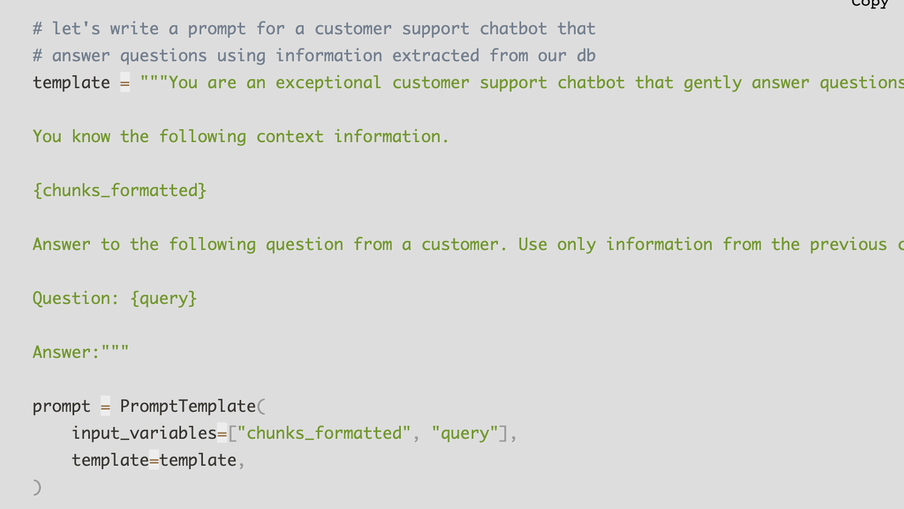

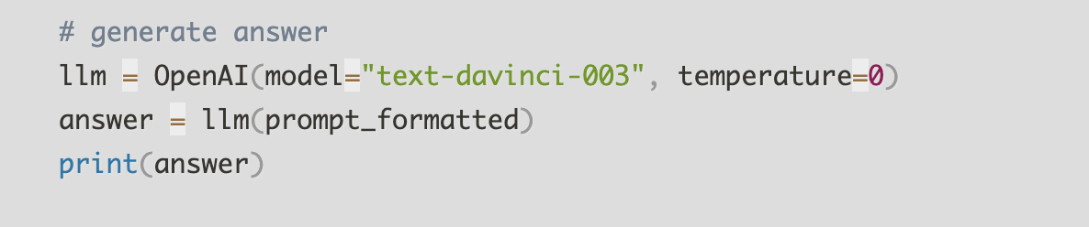
Question and Answers
Somewhat of a newer feature in search engines.
To have QnA with your data
You need to first find relevant results.
2) Craft a prompt for GPT-3 using the suggested strategies.
3: Utilize the GPT3 model with a temperature of 0 for text generation

Slide 34
QnA: Known Issues
LLMs can still hallucinate and may have leaky abstractions.
LLMs are less likely to generate bad results if user's question is within bounds of semantic search.
For ambiguous questions, there is sometimes a risk of hallucinations.
Notes:
We will discuss some of the known challenges and issues associated with Language Models (LLMs) in Question and Answer (QnA) scenarios. Let's explore the potential pitfalls and limitations that users should be aware of when utilizing LLMs for answering questions.
1. Hallucination and Leaky Abstractions:
Despite their advancements, LLMs can still suffer from hallucination, where they generate responses that contain false or fabricated information.
Hallucinations may occur when the models lack access to the full context of a query or when they encounter incomplete or ambiguous inputs.
Leaky abstractions refer to instances where the model's understanding of the input is limited or incomplete, leading to potentially erroneous outputs.
2. Semantic Search Boundaries:
LLMs are less likely to generate inaccurate or irrelevant results when the user's question falls within the bounds of semantic search.
Semantic search allows the models to better understand the context and intent of the query, leading to more relevant and accurate responses.
However, pushing the boundaries of semantic search with ambiguous or vague questions may increase the risk of hallucinations or misleading answers.
3. Ambiguous Questions and Hallucinations:
Ambiguous questions, where the intent is not clear or the query lacks context, pose a challenge for LLMs.
In such cases, the models may generate hallucinated responses based on their interpretation of the question, leading to potentially inaccurate or irrelevant answers.
Users should be cautious while posing ambiguous questions and consider providing additional context to improve result accuracy.

Slide 35
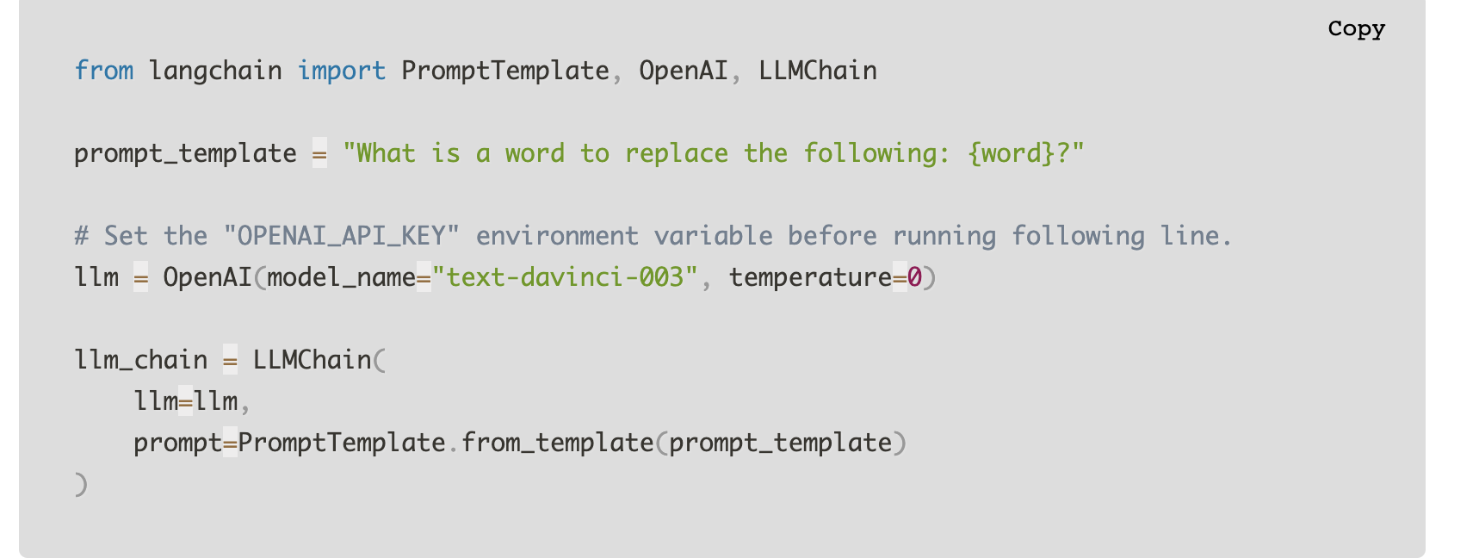
Chains
responsible for creating an end-to-end pipeline for using the language models.
Abstraction for somewhat lower level components we just discussed.
A LLMChain is the most common type of chain. It consists of a PromptTemplate, a model (either an LLM or a ChatModel), and an optional output parser.
Notes:
1. What are Chains?
Chains serve as an essential mechanism for creating an end-to-end pipeline that integrates various components for language model utilization.
They abstract the somewhat lower-level components we discussed earlier, providing a higher-level representation of the workflow.
2. LLMChain: The Common Type of Chain
The LLMChain is the most frequently used type of chain, designed to work seamlessly with Language Models like GPT Family or ChatModels.
It consists of three key components:
PromptTemplate: A template that defines the structure and format of the prompts fed to the language model.
Model: This component represents the actual language model, which can be an LLM or a ChatModel.
Optional Output Parser: An optional component that processes and parses the model's output to present the final response in a desired format.
The "Chains" slide introduces the concept of chains as end-to-end pipelines for language model usage. The LLMChain, in particular, comprises the PromptTemplate, the model (LLM or ChatModel), and an optional output parser to streamline the language model's application. Chains provide a structured and efficient approach to leverage language models effectively. The LLMChain, with its components, offers a powerful mechanism for generating meaningful and contextually relevant responses.

Slide 36
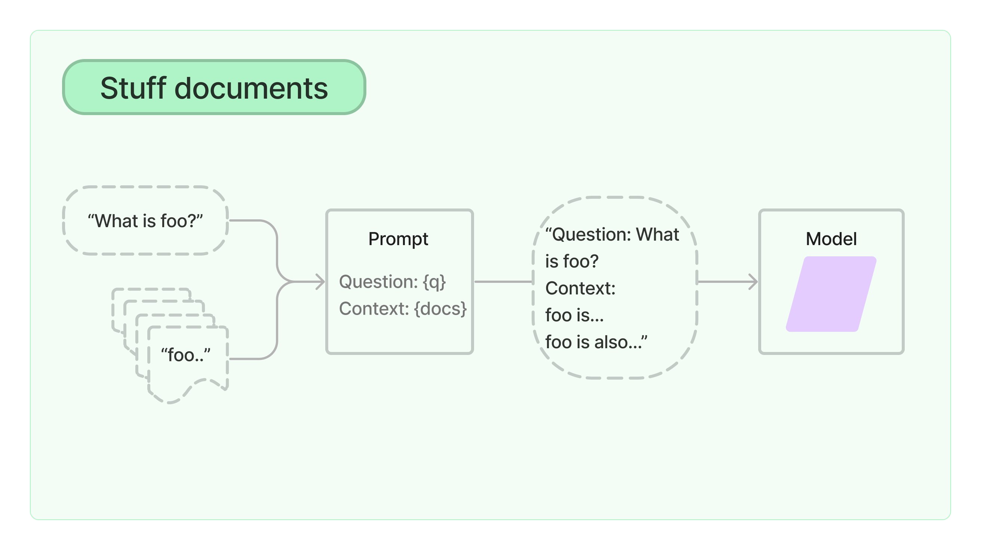
Chain Types: Stuff
takes a list of documents, inserts them all into a prompt and passes that prompt to an LLM.
Pros: Only makes a single call to the LLM. When generating text, the LLM has access to all the data at once.
Cons: Most LLMs have a context length, and for large documents (or many documents) this will not work as it will result in a prompt larger than the context length.
Notes:
We will discuss the concept of "Stuff" chains and their significance in handling a list of documents. The "Stuff" chain type takes a list of documents, inserts them all into a prompt, and passes that prompt to an LLM (Language Model). Let's explore the pros and cons of "Stuff" chains and understand their practical implications.
1. "Stuff" Chains: An Overview
A "Stuff" chain is designed to process multiple documents simultaneously by combining their content into a single prompt.
This single prompt is then fed to the LLM, allowing it to have access to all the data at once during text generation.
2. Pros of "Stuff" Chains
Efficiency: "Stuff" chains make only a single call to the LLM, streamlining the process and reducing computational overhead.
Comprehensive Context: By presenting all documents in the prompt, the LLM gains a broader context, potentially enhancing the quality of generated responses.
3. Cons of "Stuff" Chains
Context Length Limitation: Most LLMs have a context length, which restricts the size of the prompt they can process.
Limitations with Large Documents: For large documents or a substantial number of documents, the prompt size might exceed the context length, making "Stuff" chains unsuitable.
4. Example (Chart): [Explanation of Chart:]
In the example, multiple documents are represented by "foo..." and "foo is...".
The documents are stuffed into the prompt along with a specific question (e.g., "What is foo?").
The prompt contains both the question (q) and the context (docs) formed by combining the documents. This combined prompt is then passed to the LLM for generating the response.
The "Chain Types: Stuff" slide introduces the concept of "Stuff" chains, which efficiently process multiple documents through a single prompt. While "Stuff" chains offer benefits like comprehensive context, they need to consider the context length limitation of LLMs when dealing with large documents or numerous data items.

Slide 37
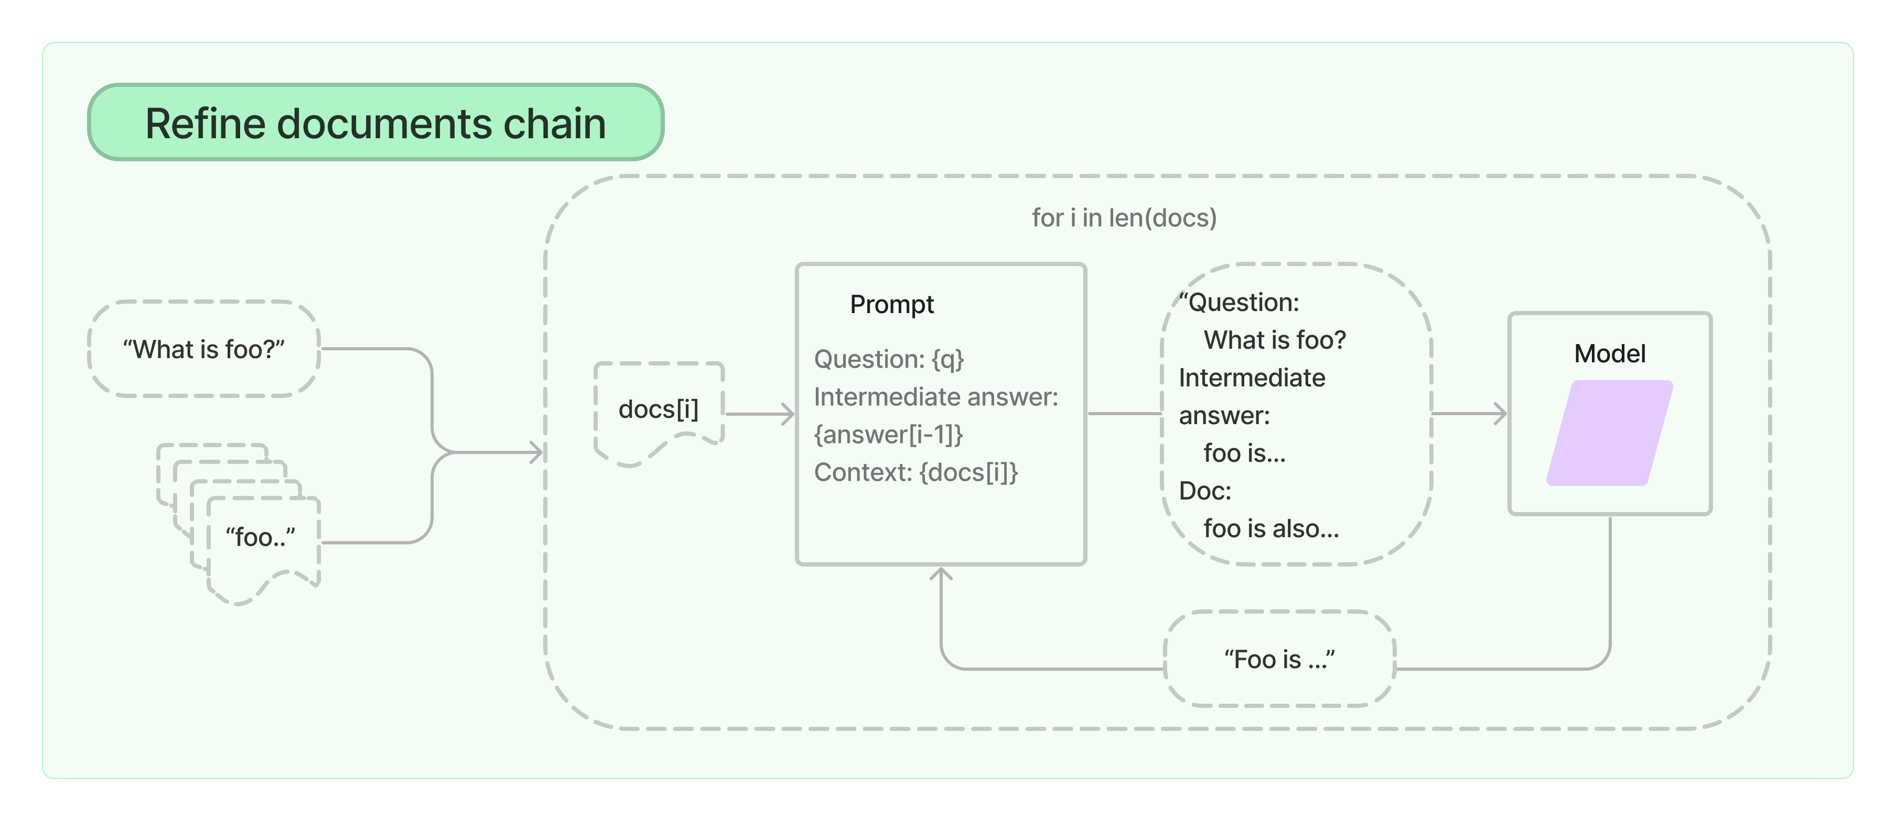
Chain Types: Refine
Constructs a response by looping over the input documents and iteratively updating its answer.
For Each document, it passes all non-document inputs, the current document, and the latest intermediate response to an LLM chain to get a new solution.
Pros: Can scale to more significant documents (and more documents) than StuffDocumentsChain. The calls to the LLM on individual records are independent and can therefore be parallelized.
Cons: Requires many more calls to the LLM than StuffDocumentsChain. Loses some information during the final combined call.
Notes:
We will explore the "Refine" chain type and its role in constructing responses by iteratively updating answers. The "Refine" chain type processes input documents in a loop, passing them along with non-document inputs and the latest intermediate response to an LLM chain. Let's examine the pros and cons of "Refine" chains and understand their practical applications.
1. "Refine" Chains: An Overview
A "Refine" chain is designed to construct responses by iteratively updating answers based on input documents.
For each document, the "Refine" chain passes all non-document inputs, the current document, and the latest intermediate response to an LLM chain, generating a new solution.
2. Pros of "Refine" Chains
Scalability: "Refine" chains can efficiently handle more significant documents and a larger number of documents compared to "StuffDocumentsChain."
Parallelization: Calls to the LLM for individual records are independent, allowing parallelization and improved performance.
3. Cons of "Refine" Chains
Increased LLM Calls: "Refine" chains require more calls to the LLM compared to "StuffDocumentsChain," potentially impacting execution time.
Information Loss: During the final combined call, some information may be lost due to the iterative nature of updating answers.
4. Example (Map): [Explanation of Map:]
The refine documents chain constructs a response by looping over the input documents and iteratively updating its answer. For each document, it passes all non-document inputs, the current document, and the latest intermediate answer to an LLM chain to get a new answer.
Since the Refine chain only passes a single document to the LLM at a time, it is well-suited for tasks that require analyzing more documents than can fit in the model's context. The obvious tradeoff is that this chain will make far more LLM calls than, for example, the Stuff documents chain. There are also certain tasks which are difficult to accomplish iteratively. For example, the Refine chain can perform poorly when documents frequently cross-reference one another or when a task requires detailed information from many documents.
The "Chain Types: Refine" slide introduces the concept of "Refine" chains, which efficiently construct responses by iteratively updating answers based on input documents. While "Refine" chains offer scalability and parallelization, they require more LLM calls and may involve some information loss during the final combination.

Slide 38
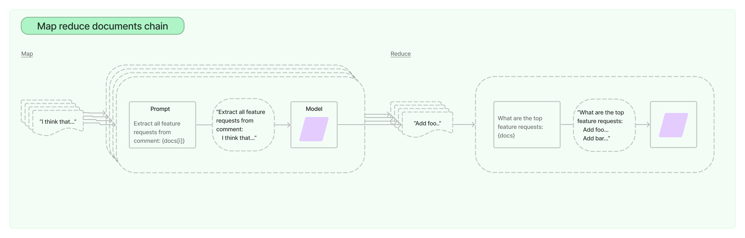
Chain Types: Map Reduce
first applies an LLM chain to each document individually (the Map step), treating the chain output as a new document.
It then passes all the new documents to a separate combined documents chain to get a single output (the Reduce step)
Pros: Can scale to more significant documents (and more documents) than StuffDocumentsChain. The calls to the LLM on individual documents are independent and can therefore be parallelized.
Cons: Requires many more calls to the LLM than StuffDocumentsChain. Loses some information during the final combined call.
Notes:
We will explore the "Map Reduce" chain type and its role in processing documents in two steps: Map and Reduce.
1. "Map Reduce" Chains: An Overview
A "Map Reduce" chain involves two steps: Map and Reduce.
In the Map step, the chain applies an LLM chain to each document individually, treating the chain output as a new document.
In the Reduce step, all the new documents are passed to a separate combined documents chain to generate a single output.
2. Pros of "Map Reduce" Chains
Scalability: "Map Reduce" chains can efficiently handle more significant documents and a larger number of documents compared to "StuffDocumentsChain."
Parallelization: Calls to the LLM for individual documents are independent, allowing parallelization and improved performance.
3. Cons of "Map Reduce" Chains
Increased LLM Calls: "Map Reduce" chains require more calls to the LLM compared to "StuffDocumentsChain," potentially impacting execution time.
Information Loss: Some information may be lost during the final combined call, similar to the "Refine" chain.
The map reduce documents chain first applies an LLM chain to each document individually (the Map step), treating the chain output as a new document. It then passes all the new documents to a separate combine documents chain to get a single output (the Reduce step). It can optionally first compress, or collapse, the mapped documents to make sure that they fit in the combine documents chain (which will often pass them to an LLM). This compression step is performed recursively if necessary.

Slide 39
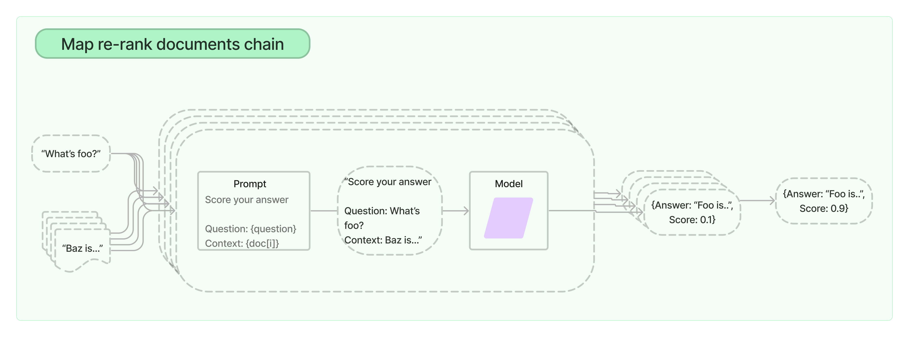
Chain Types: Map Rerank
Runs an initial prompt on each document, that not only tries to complete a task but also gives a score for how certain it is in its answer. The highest scoring response is returned.
Pros: Similar pros as MapReduceDocumentsChain. Requires fewer calls, compared to MapReduceDocumentsChain.
Cons: Cannot combine information between documents. This means it is most useful when you expect there to be a single simple answer in a single document.
Notes:
We will explore the "Map Rerank" chain type and its role in running an initial prompt on each document to not only complete a task but also give a score for how certain it is in its answer. The "Map Rerank" chain type returns the highest scoring response. Let's examine the pros and cons of "Map Rerank" chains and understand their practical applications.
1. "Map Rerank" Chains: An Overview
A "Map Rerank" chain runs an initial prompt on each document to complete a task and provides a score indicating its confidence in the answer.
The chain then returns the highest scoring response as the final output.
2. Pros of "Map Rerank" Chains
Similar Pros as "Map Reduce": "Map Rerank" chains offer scalability and parallelization, requiring fewer LLM calls compared to "MapReduceDocumentsChain."
3. Cons of "Map Rerank" Chains
Cannot Combine Information: "Map Rerank" chains cannot combine information between documents. They are most useful when expecting a single simple answer in a single document.
4. Example (Map Rerank): [Explanation of Map Rerank:]
In the example, a list of documents is represented by "Document 1" and "Document 2".
The "Map Rerank" chain runs an initial prompt on each document and assigns a score to each response.
The chain then returns the response with the highest score as the final output.
The "Chain Types: Map Rerank" slide introduces the concept of "Map Rerank" chains, which efficiently process documents by running an initial prompt on each document and returning the highest scoring response. While "Map Rerank" chains offer scalability and reduced LLM calls, they are most suitable for cases where a single simple answer is expected in a single document.

Slide 40

Chat Interfaces and Gradio
Prototyping tool for ML applications on UI.

Slide 41
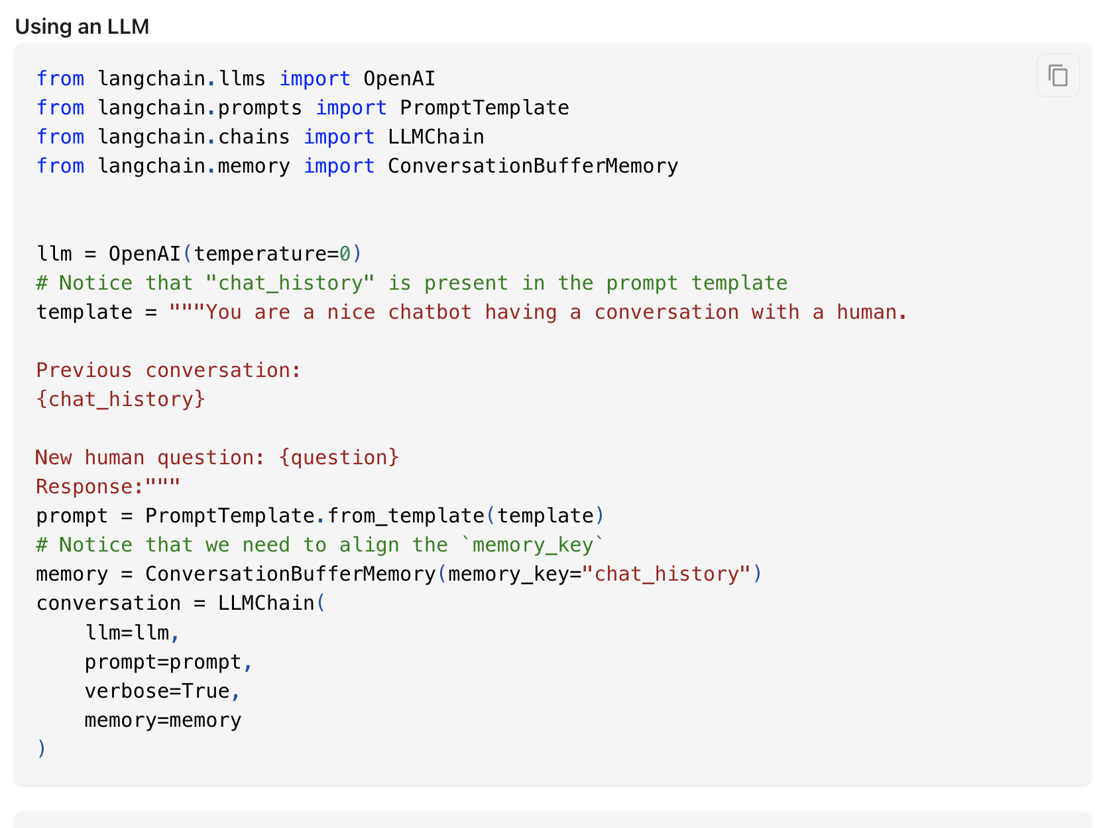
Memory
Essential component of a conversation is being able to refer to information introduced earlier in the conversation.

Slide 42
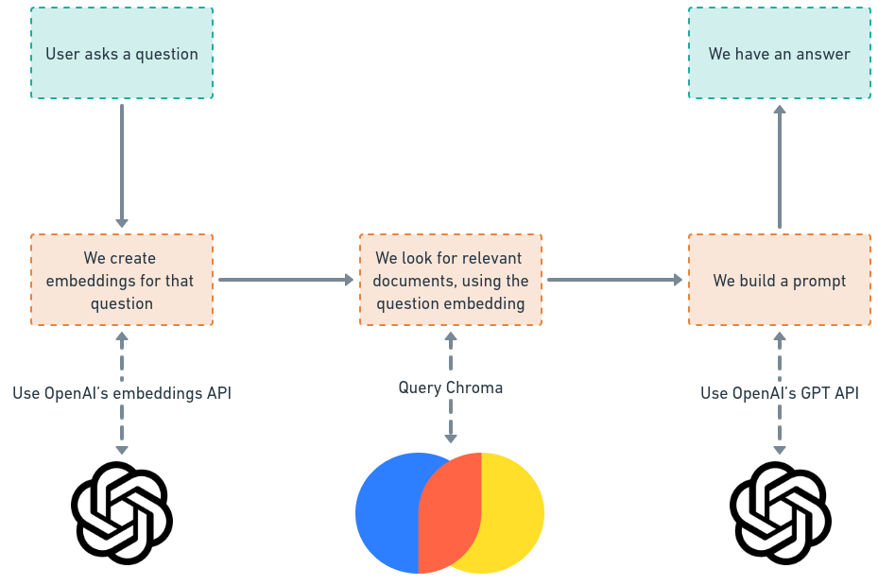
Demo
Notes:
Step 1: User Asks a Question The process begins when a user asks a question or provides an input query. This question can be on any topic, and it serves as the basis for retrieving relevant information.
Step 2: Create Embeddings for the Question To represent the user's question in a format suitable for computer processing, we create embeddings for the question. Embeddings are dense vector representations that encapsulate semantic information about the text. In this step, we use OpenAI's embedding API to generate the embeddings for the user's question.
Step 3: Look for Relevant Documents With the question's embeddings in hand, we use a retrieval method called "Query Chroma" to find relevant documents. The "Query Chroma" process involves searching through a collection of documents to identify those that contain information closely related to the user's question. By using the question's embedding as a reference, we can efficiently retrieve documents that are likely to have the answer the user is seeking.
Step 4: Build a Prompt Once we have identified relevant documents, we proceed to build a prompt for generating a comprehensive answer. To achieve this, we utilize OpenAI's GPT (Generative Pre-trained Transformer) language model. The prompt acts as a context for the language model and includes the relevant information from the retrieved documents along with the user's original question.
Step 5: Obtain the Answer With the prompt in place, we input it into the GPT language model, which generates a response based on the combined context of the user's question and the relevant documents. The generated answer provides valuable information and insights in response to the user's original query.
Summary: The entire process involves the user asking a question, converting the question into embeddings, finding relevant documents based on the embeddings, building a prompt using the retrieved information, and finally obtaining a comprehensive answer through the GPT language model. This method enables efficient and accurate retrieval of information and helps users receive relevant and meaningful answers to their queries.

Slide 43
Evaluating Search Systems
Automatically Generate questions and setup LLMOPs pipelines
Need to version your embeddings.
Notes:
https://blog.langchain.dev/auto-eval-of-question-answering-tasks/
https://autoevaluator.langchain.com/
Effective evaluation is vital for optimizing search systems, ensuring their accuracy, and providing valuable insights for continuous improvement. By employing automatic question generation and proper versioning of embeddings, we can conduct comprehensive evaluations and enhance the performance of search systems.
1. Automatically Generate Questions and Setup LLMOPs Pipelines
To evaluate search systems, it is essential to simulate real-world scenarios by automatically generating diverse and relevant questions.
LLMOPs (Language Model Optimization for Production Systems) pipelines can be set up to test and measure the performance of search systems under different conditions.
2. Version Your Embeddings
Embeddings, which represent dense vector representations of data, are a critical component of search systems.
It is important to version your embeddings to keep track of changes and improvements over time.
Versioning ensures reproducibility and consistency in search system evaluations, allowing easy comparison of results across different iterations.

Slide 44
Ranking
Typically search results are also ranked before passing to QnA or shown to the user.
Combination of automatic ranking and human feedback
Ranking algo like Cross Encoders.
Notes:
We will explore the essential aspect of ranking search results in the context of QnA systems. Ranking plays a crucial role in presenting the most relevant and accurate information to users. Let's delve into the key points related to ranking in QnA systems.
1. Typically Search Results are Ranked
In QnA systems, search results are often ranked before being presented to users or passed to the question-answering process.
The ranking process ensures that the most relevant and useful information appears at the top, making it easier for users to find what they are looking for.
2. Combination of Automatic Ranking and Human Feedback
Ranking algorithms often involve a combination of automatic techniques and human feedback.
While automatic algorithms use various similarity measures and metrics, human feedback helps validate and fine-tune the ranking to match user preferences and expectations.
3. Ranking Algorithm: Cross Encoders
One commonly used ranking algorithm in QnA systems is Cross Encoders.
Cross Encoders are neural network models that learn to rank pairs of questions and answers based on their relevance and similarity.
These models leverage deep learning techniques to achieve high accuracy in ranking search results.
Accurate and effective ranking is essential to ensure that users receive the most relevant and helpful information in QnA systems. By employing sophisticated ranking algorithms like Cross Encoders and incorporating human feedback, we can enhance the search experience and deliver superior search results.

Slide 45
Common issues
Issue 1: Running into errors related to the prompt length
Solution: Decrease one or many of k, chunk_size, and max_tokens.
Issue 2: The answers contain hallucinations or do not match the true data content
Solution: Decrease the temperature. Set it to 0 for the most conservative answers that are unlikely to deviate from the sources.
Issue 3: The answers are not relevant enough
Solution: Increase chunk_size, or if this leads to running into issue 1, then increase k and fetch_k while decreasing chunk_size

Slide 46
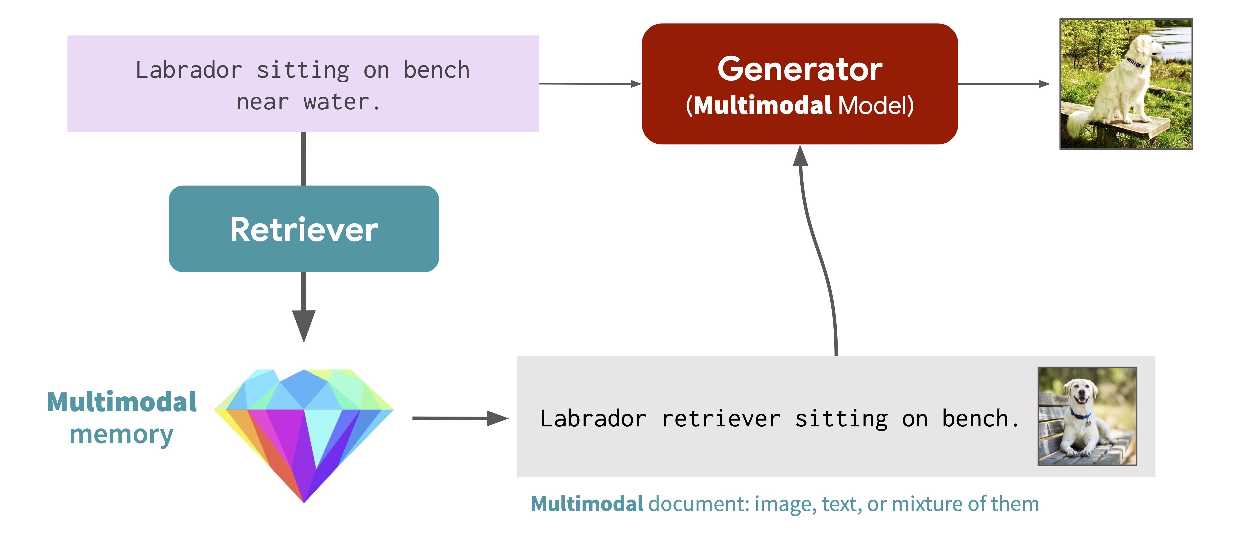
Future of Search: Multimodal RAG
https://cs.stanford.edu/~myasu/blog/racm3/
Notes:
As illustrated in the figure above, given a multimodal prompt, the model uses a retriever to fetch relevant multimodal documents from an external memory, and uses a generator to refer to the retrieved documents to generate a response to the prompt (e.g., generate an image for a text prompt, generate a caption for an image prompt). For instance, when generating an image for a caption “Labrador sitting on a bench near water”, now the model can retrieve and attend to an image of a labrador as a reference, without requiring the model to memorize the appearance of a labrador in its internal parameters.

Slide 47

!

